Slide 1
CTE Transitions CATEMA Teacher Tutorial
Part Three: Class Grading Procedures

Slide 2
Log In to your CATEMA Account

Slide 3
Click: View Class List

Slide 4
Click: Blue Arrow on Class List you are grading.

Slide 5
Click: View directly across from student you are grading.

Slide 6
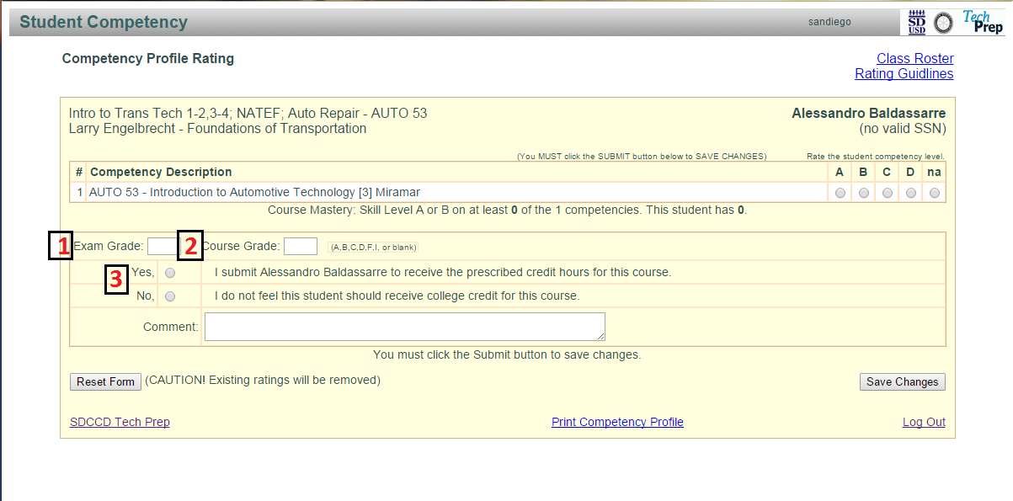
For each student, teachers must input: 1. Exam Grade 2. Course Grade 3. Credit Recommendation Click: Class Roster to return the main list of students.

Slide 7
When you are finished grading ALL your students... Click: Student List at the bottom of your Roster

Slide 8
Verify all student grades are correct and print* Student Roster. *Sign and Date in ink and then scan and send to SDCCD CTE Transitions office via email or snail mail.

Slide 9
How Students Request College Credit:
1. Student must successfully complete CATEMA system enrollment during the high school CTE course. (see CATEMA Student Tutorial)
2. Student must earn a grade of ‘A’ or ‘B’ in your CTE course and on your final CTE exam or assessment .
Student must complete steps 3, 4 and 5 no later than 18 months after high school graduation:
(Example: If they graduate in June 2016, they have until December 2017 to complete the final steps for credit)
3. Student completes SDCCD online college application
(Website link: https://applyonline.communitycollege.net/studentappview.cfm)
4. Student submit Student Petition for Credit to CTE Transitions Office
(Download link: http://techprep.sdccd.edu/resources/CTE_Transitions_Petition_for_Credit.pdf)
5. Student submit official high school transcript to CTE Transitions Office

Slide 10
For Program Assistance…
Please contact our office at (619) 388-6572
OR
Visit our website at techprep.sdccd.edu

