Slide 1
Humanizing
Online Teaching
These slides are available online @ bit.ly/sdccdolsummit19
Katie Palacios
Notes:
Welcome.

Slide 2
Meet Your Neighbors
Form small groups (of 2 or 3)
Intros (2 mins. total)
Your Name, Discipline
Why do you teach online?
These slides are available online @ bit.ly/sdccdolsummit19

Slide 3
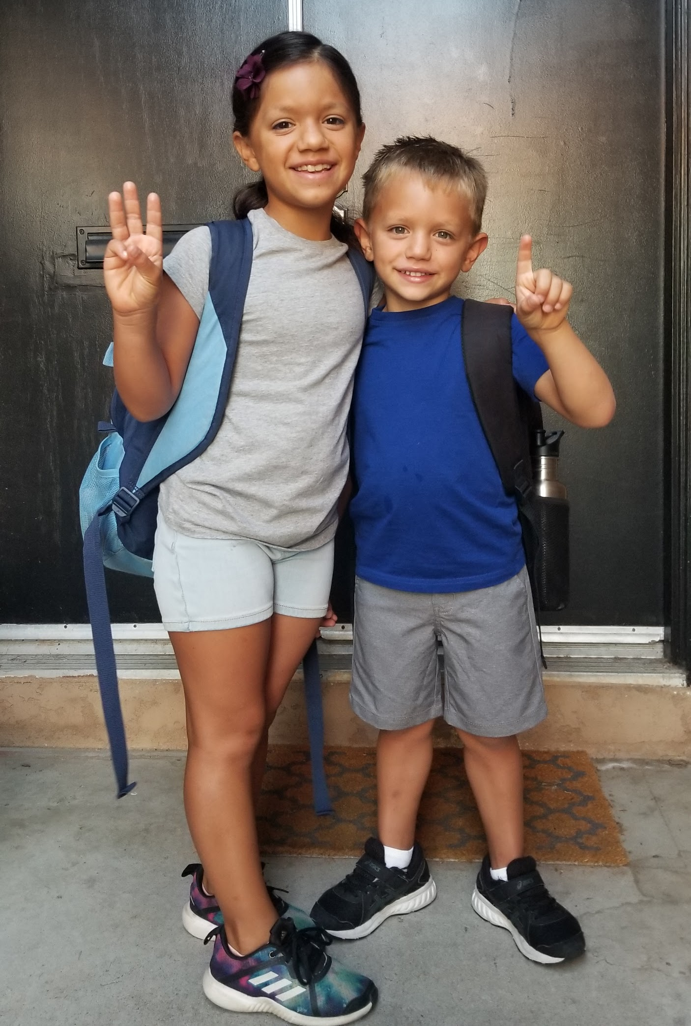
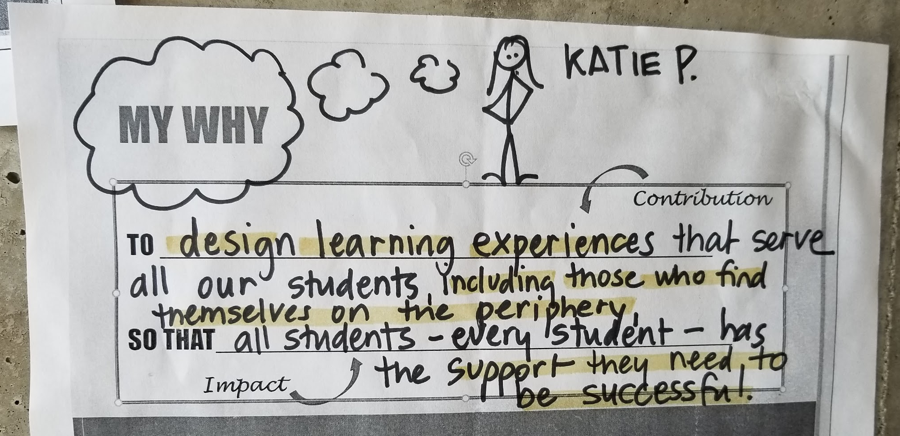
Meet Me
Mom to Abi & Jack
Instructional Designer, Faculty Support
Taught online @City, Miracosta, & SWC
I co-facilitate @ONE’s 10-10-10 course

Slide 4
I work for the CCCs
These slides are available online @ bit.ly/sdccdolsummit19
“As the largest system of higher education in the nation, the California Community Colleges is uniquely positioned to help residents of all backgrounds improve their social and economic mobility and build a better future for themselves and their families.”
-From CCC State of the System

Slide 5
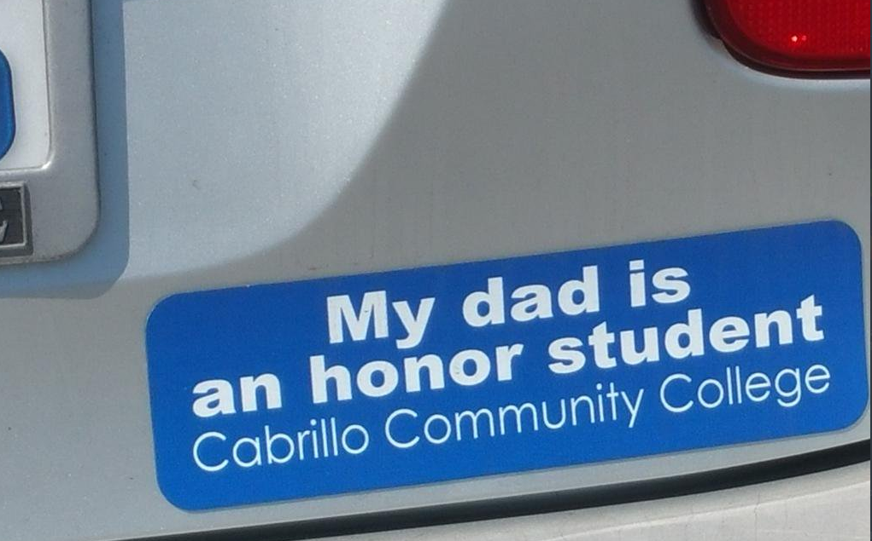

Slide 6
#RealCollege Survey
These slides are available online @ bit.ly/sdccdolsummit19
Almost 40,000 students at 57 California Community Colleges participated.
The results indicate:
50% of respondents were food insecure in the prior 30 days,
60% of respondents were housing insecure in the previous year,
19% of respondents were homeless in the previous year.
Real College Survey

Slide 7
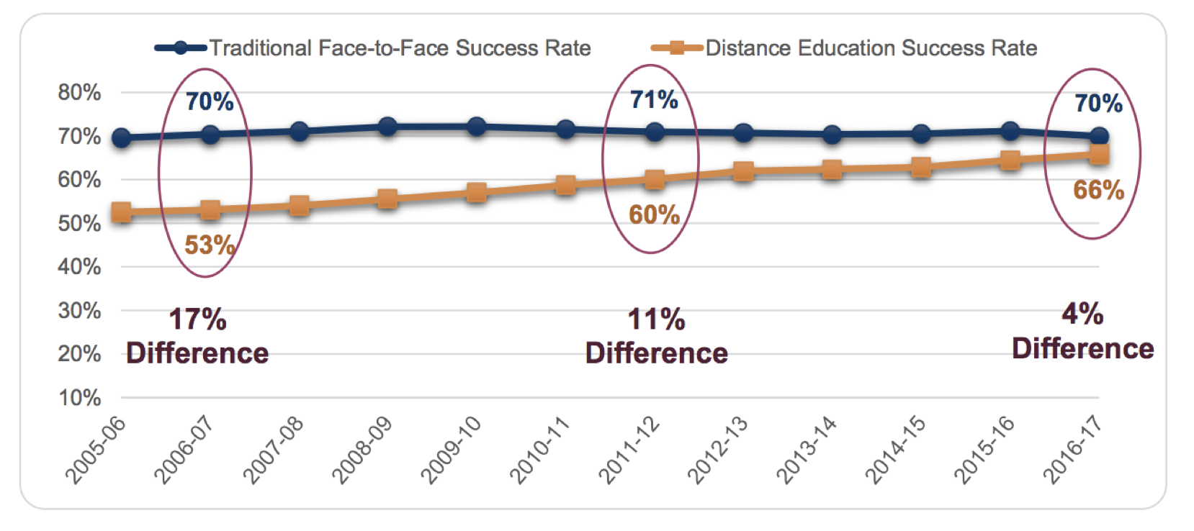
CCC: Face-to-Face vs Distance Ed Success Rates
These slides are available online @ bit.ly/sdccdolsummit19
Source: 2017 CCC Distance Education Report, CA Community College Chancellor’s Office

Slide 8
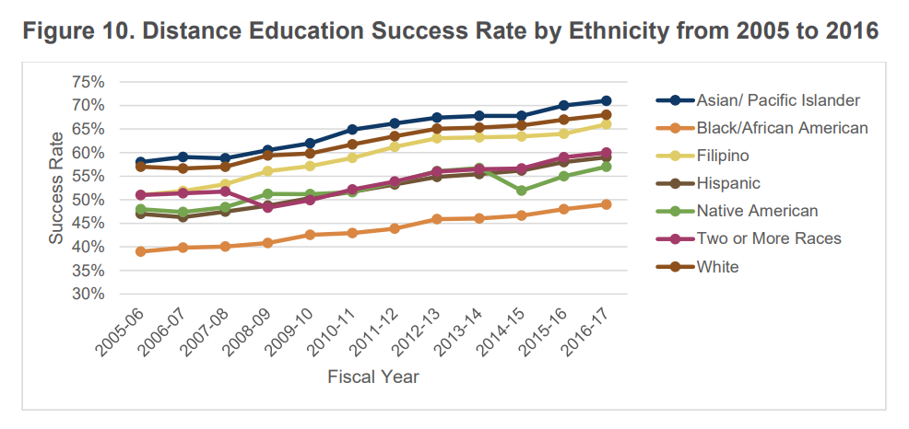
CCC: Distance Ed Success Rates by Ethnicity
Source: 2017 CCC Distance Education Report, CA Community College Chancellor’s Office

Slide 9
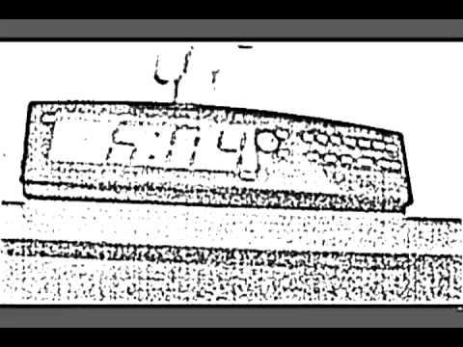
How accurate is this depiction of online classes?
These slides are available online @ bit.ly/sdccdolsummit19

Slide 10
The Student Perspective
Daniel Contreras, student at Solano Community College,
shares his perspective on being an online student
Notes:
Daniel Contreras video - start at 2:35 - 6:13

Slide 11
These slides are available online @ bit.ly/sdccdolsummit19
Oh wow.
Someone’s like paying attention.

Slide 12
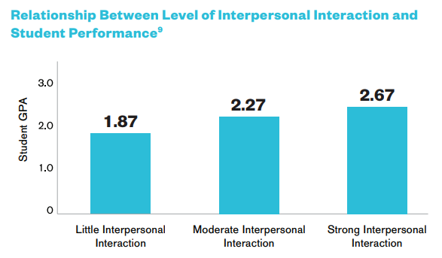
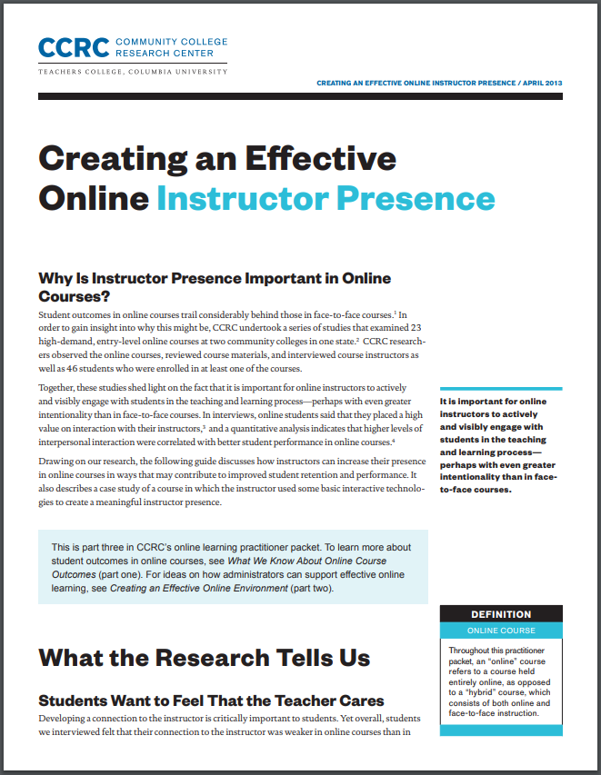
See Creating an Effective Online Instructor Presence to learn more.

Slide 13
Don’t be a robot.

Slide 14
Presence is
the most important
best practice for an online course.
Boettcher & Conrad, 2010, p. 53
The Online Teaching Survival Guide

Slide 15
Read this book!
Hammond, Z. (2015). Culturally responsive teaching and the brain: Promoting authentic engagement and rigor among culturally and linguistically diverse students.

Slide 16
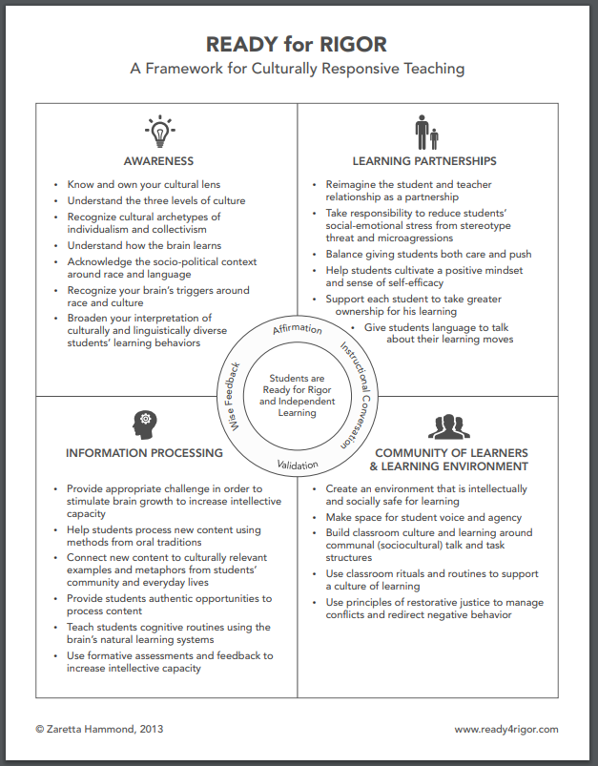
A Framework for Culturally Responsive Teaching by Zaretta Hammond
Awareness
Learning Partnerships
Information Processing
Community of Learners & Learning Environment
Notes:
In her Ready for Rigor framework, Hammond shares how teachers can set the stage for transforming dependent learners to independent learners in four key practice areas of Culturally Responsive Teaching:
Awareness - knowing our own cultural context, biases, triggers, lens.
Learning Partnerships - building supportive caring
Information Processing
Community of Learners & Learning Environment

Slide 17
"Humanizing Your Online Class infographic" by Michelle Pacansky-Brock is licensed under CC BY-NC 4.0

Slide 18
Don’t apply the “Set it & forget it” approach.

Slide 19
It doesn’t have to mean redesigning your whole course...
Laura’s Story: “Is everything okay?”
Notes:
In Canvas, this is even easier to do with the “Message Students Who” link in grades

Slide 20
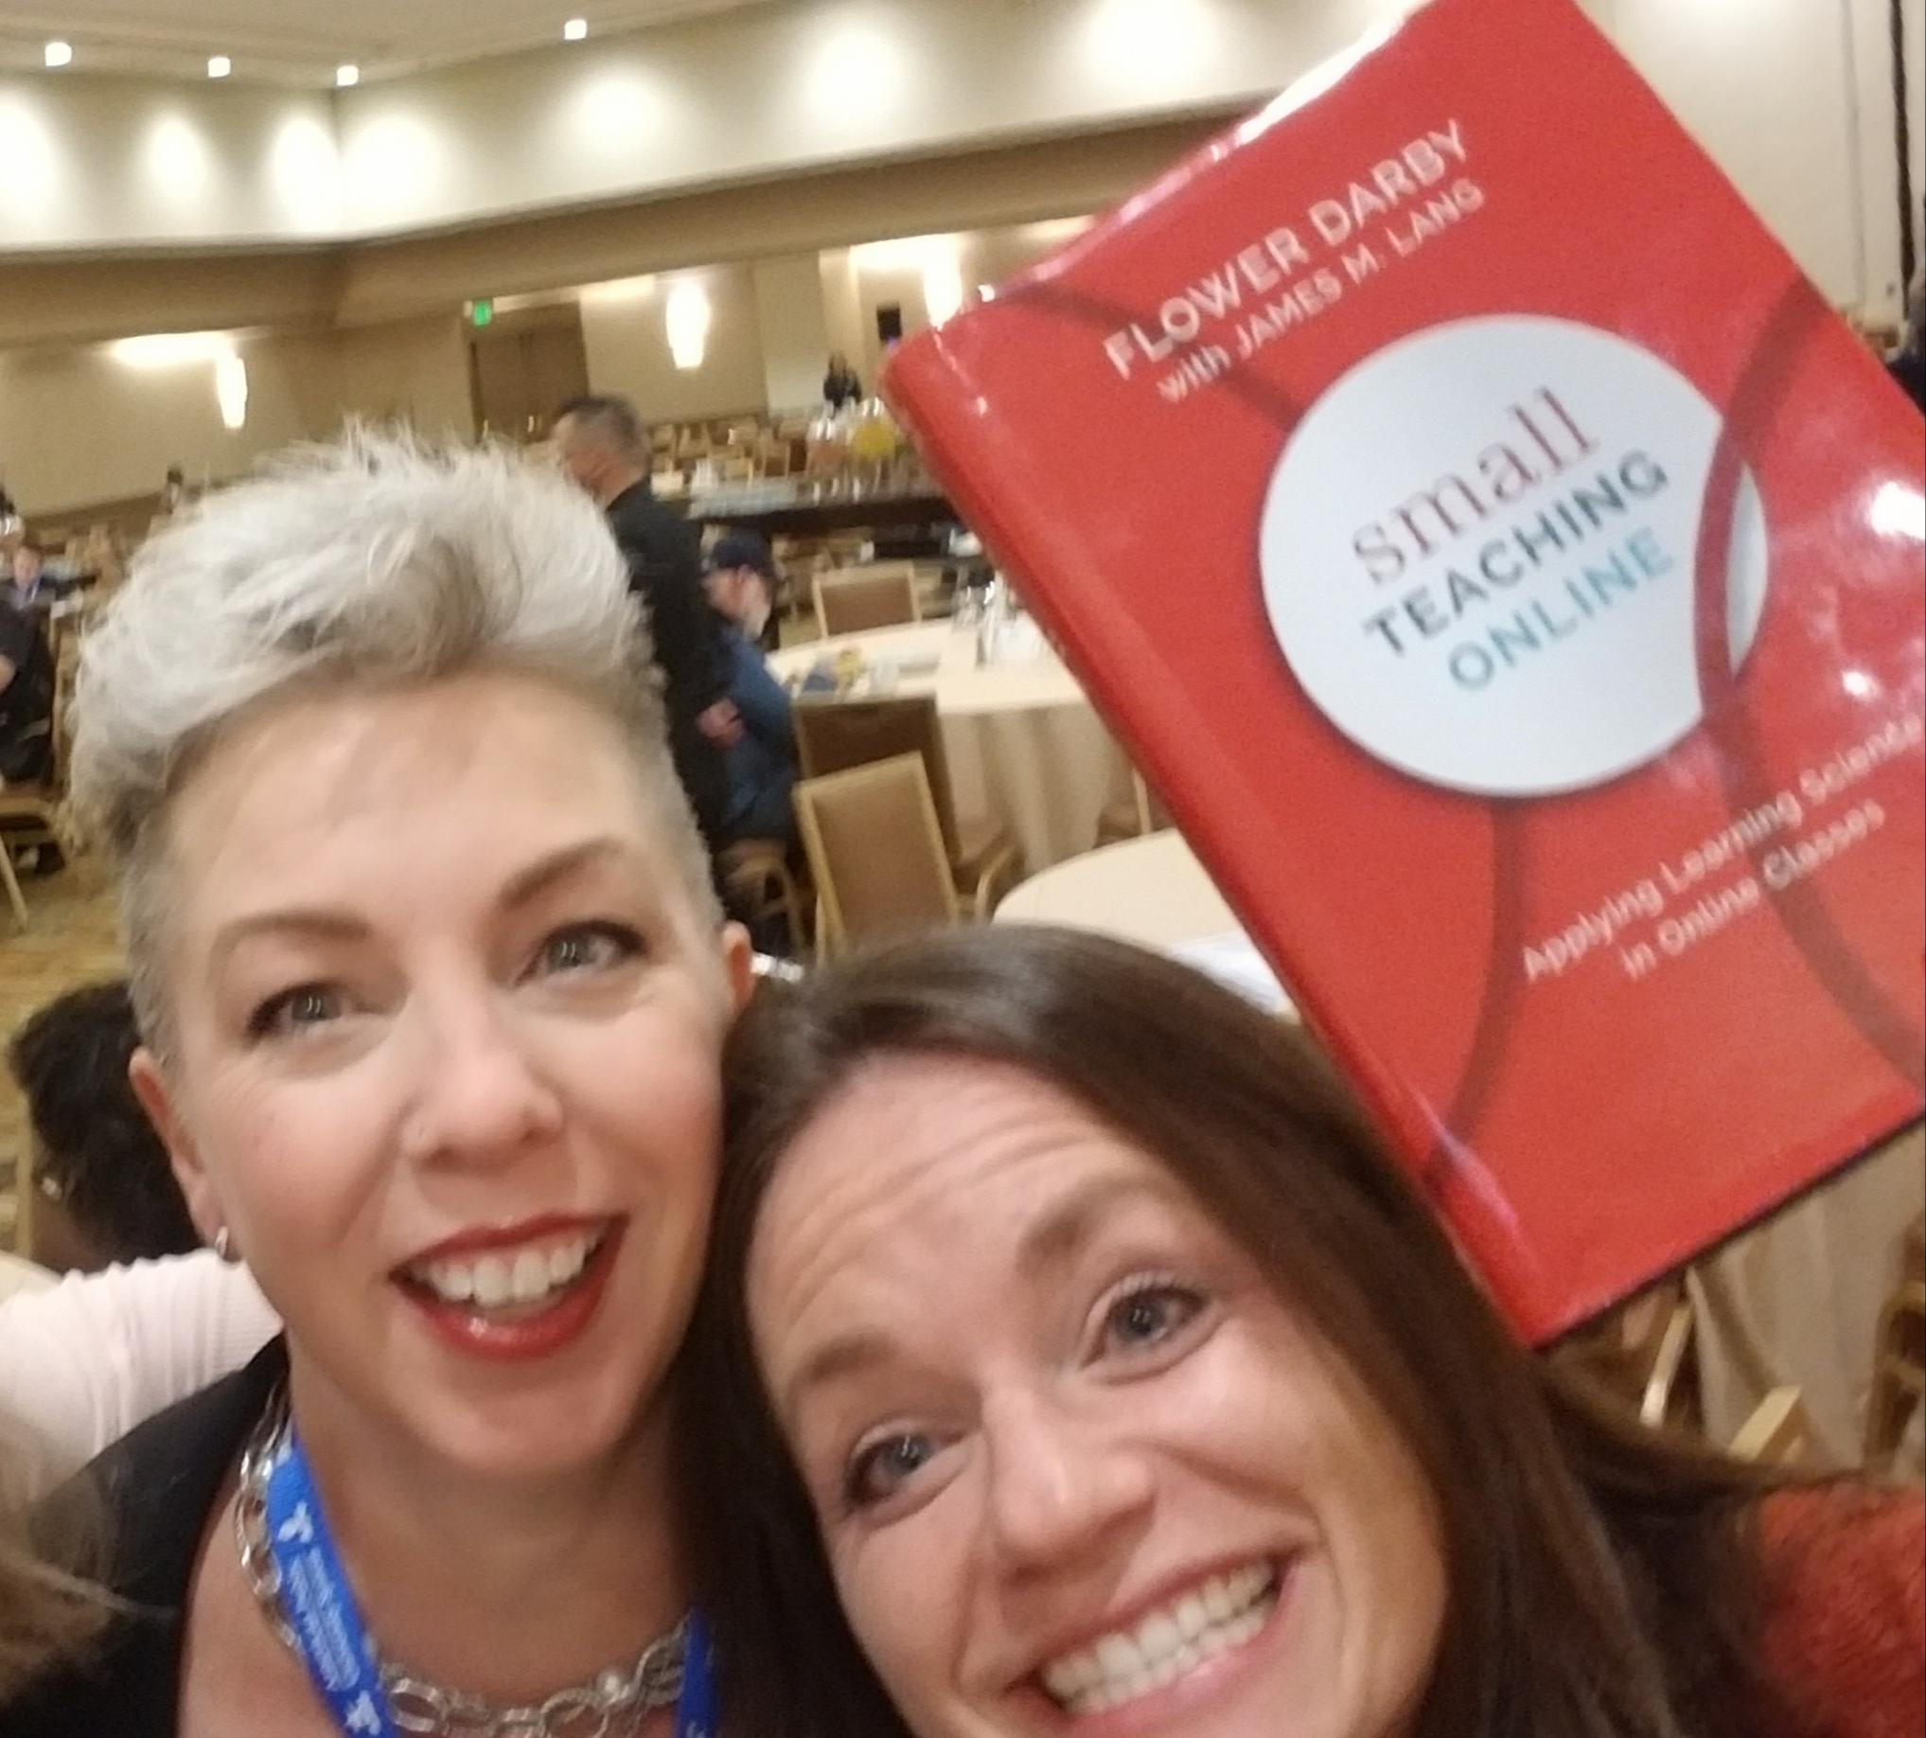
http://onlineteachingconference.org/otc19-archives/

Slide 21
Let’s Collect Humanizing Practices
On Paper or
On Padlet: bit.ly/humanizede

Slide 22
#ImperfectIsPerfect

Slide 23
Email from a Mesa faculty member who humanizes...
“I ran some analytics about my online class spring 19 and I had the highest success rate spring 19 of all the online courses in my department! I can’t really brag to my co-workers, so I thought I’d brag to you. To be honest I was surprised by that, but I ended up doing a lot in ‘intrusive support’ (calling students on the phone and asking to see them in person when they were on campus) with students who were not passing my class or who were falling behind.”

Slide 24
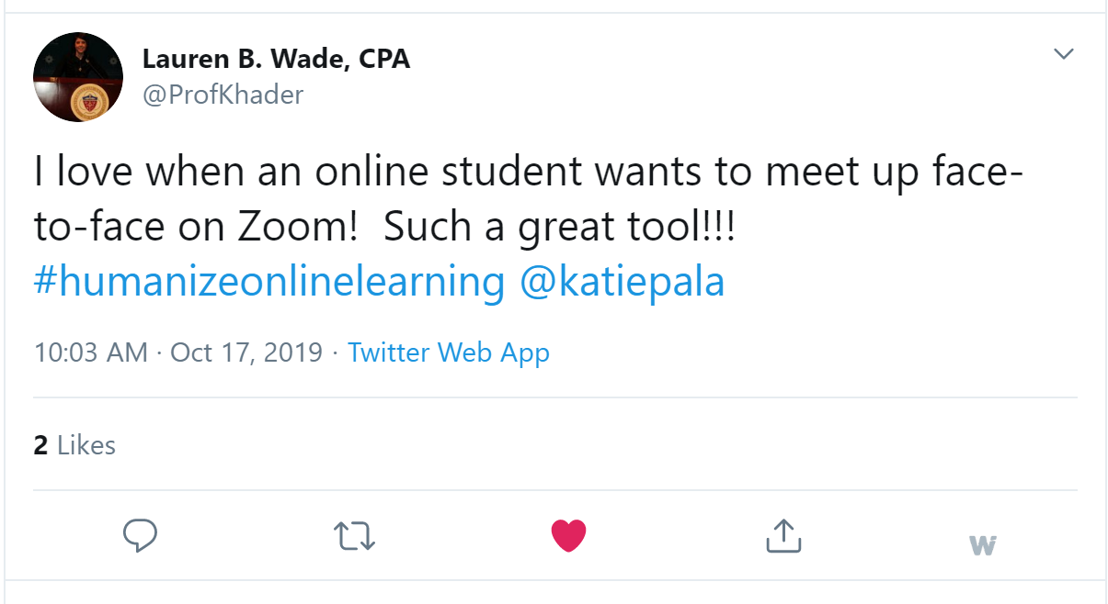

Slide 25
Dig Further
Michelle Pacansky-Brock’s Humanizing Infographic
Small Teaching Online by Flower Darby
Culturally Responsive Teaching & the Brain by Z. Hammond
Online Teaching Conference! June 2020 in Pasadena
OTC 2019 - Conference Archives
Creating an Effective Online Instructor Presence
2017 CCC Distance Education Report, CCC Chancellor’s Office

Slide 26
Teaching online is difficult to do well.
Look at your course outcomes data.
Find support. Share successes.
Ask for more faculty support on your campus!
Tap into @ONE resources.

Slide 27
CVC OEI Course Design Rubric

Slide 28
onlinenetworkofeducators.org/caninnovate19/

