Slide 1
Support for Humanizing Through Context
Presented by:
Chris Rodgers and Peter Tea

Slide 2
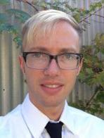
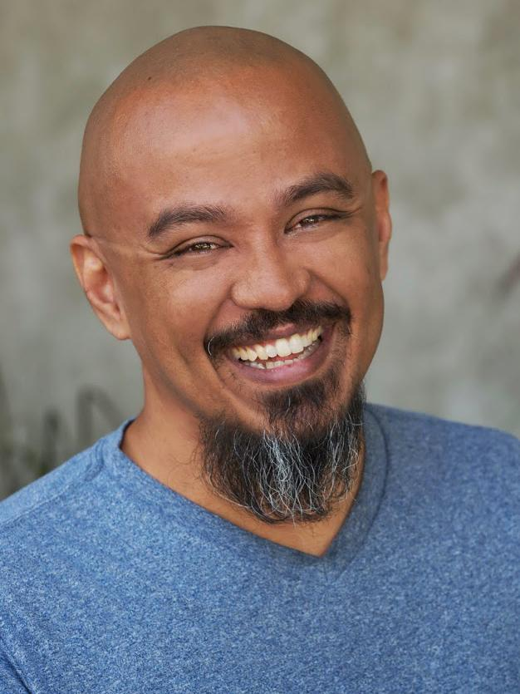
The SDOLP Team
Trenton Tidwell, M.Ed.
Instructional Design Coordinator
Online Learning Pathways
Christopher Rodgers
Instructional Design Coordinator
Online Learning Pathways
Peter Tea
Project Assistant
Online Learning Pathways
Notes:
Chris
Basic intro for us
Idk what else to put reallly

Slide 3
The Online Learning Pathways
OBJECTIVES
Explain the importance of Humanizing through Context.
Outline issues we have personally seen with online student success.
Showcase student issues and recommendations.
Explain how the SDCCD OLP Department can help you as a faculty humanize your course through Context.
Showcase faculty, their online course experience, along with their experience with the SDCCD OLP Department.
Notes:
Chris
Who we are.
What we do.
Basics like images of the office as well.
Simple format nothing too big and gaudy

Slide 4
What is Humanized Context?
Content is King but Context is God ~ Gary Vaynerchuk
Context is a practical tool that will help you build value, meaning, trust and interest for the student.
The word "context" has an abstract definition. Merriam-Webster dictionary, context is defined as "The parts of a discourse that surround a word or passage and can throw light on its meaning".
Context can be basically anything that bridges the gap between you and your student. Anything that could potentially elevate their interests or make them invested in your course.
Notes:
Chris
Humanizing through context. Understanding the end user and creating quality content that not only relates to the on personal level but establishes purpose for their end goal
A few bullet points
I’m imagining a dictionary entry where you can explain it and define it in that way
It’ll be a good format that is familiar and easy to digest.
TAKE NOTE THAT INITIAL CONTENT IS JUST TO MARK THE IDEA. BULLET POINTS WILL BE CONDENSED LATER

Slide 5
Why do we need Humanized Context?
Context matters because of the relationship created between the instructor, the student, as well as the content of the course.
In our robust hyper-connected world, everyone has access to the same information. What makes your message stand out?
Fully understanding the student is now the challenge of the instructor. This is the ultimate context and why it is so important. You are the context.
Building quality relationships real or virtual, need to be fostered in order for instructors to provide students with the content that has context. Context that they can relate to.
If the student trusts you and finds value in what you are teaching they will want to take part in your course and invest time in you.
Notes:
Chris
This is where we underline the main problem.
Disconnect with Teacher and Student
Students are isolated so motivation drops and then students drop

Slide 6
Data
Data from Datamart CCCCO
Notes:
PETER
State vs sdccd online success rate comparison

Slide 7
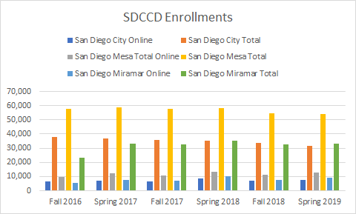
Data
Data from Datamart CCCCO
Notes:
PETER
Enrollments SDCCD

Slide 8
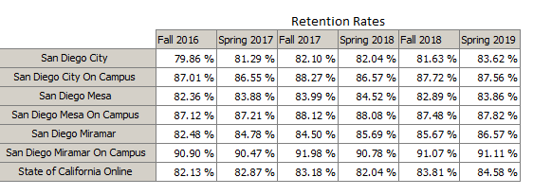
Data
Data from Datamart CCCCO
Notes:
PETER
Timeline sdccd success/retention fall 2016-spring 2019

Slide 9
The Cause
Students don’t have a relationship with their online professor and peers.
They feel isolated in their class, thus are hesitant to ask for help or assistance.
The content for online courses have no connection with the students.
Lack of assistance from their professors (no office hours, hard to contact via email, poor feedback from assignments, etc)
Poorly designed assignments that do not apply the knowledge students learn in the real world.
Notes:
PETER
Lead in to why this is happening
OVERVIEW of the topic at hand
Student isolation
Motivation and lack of relationship
CONTEXT WHERE IS IT
Give a brief summary of online classes and why people take them
Walk them through scenarios and stories

Slide 10
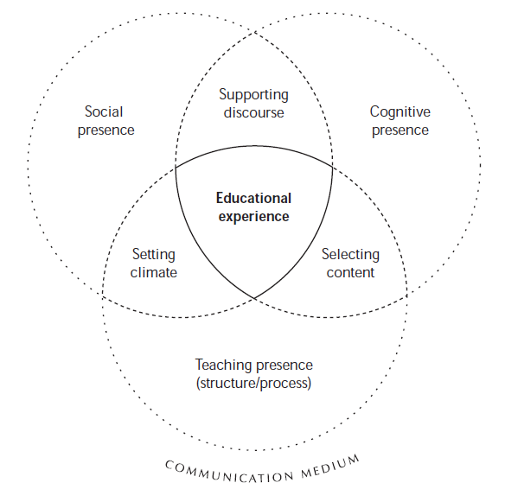
3 Teaching Presences
Theory and Practice of Online Learning by Terry Anderson
Notes:
PETER

Slide 11
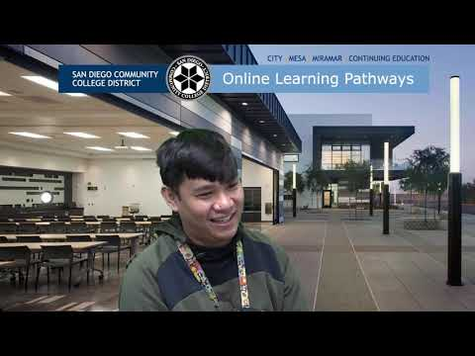
Testimonial (Student PROBLEM)
Notes:
PETER

Slide 12
Address and reflect
Students need to feel like they have a reason to take the class
By creating a relationship with the student the professor can learn how to apply the course material to the specific needs of the student. (Giving applicable assignments to reinforce the necessity of the course.)
Students no longer feel scared of interacting with peers of the professor and are more willing to share more about themselves and put more motivation and effort into the course.
Giving a purpose to the students with a clear goal in mind will help facilitate a better online environment.
Notes:
PETER

Slide 13
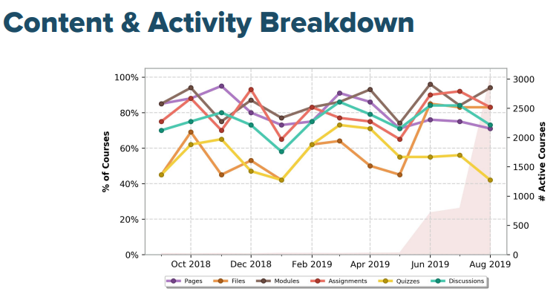
Canvas Data
Notes:
PETER
File suppository

Slide 14
3 Presences
Theory and Practice of Online Learning by Terry Anderson

Slide 15
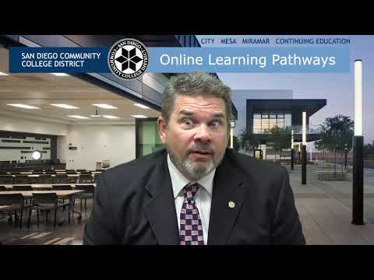
Professor Perspective

Slide 16
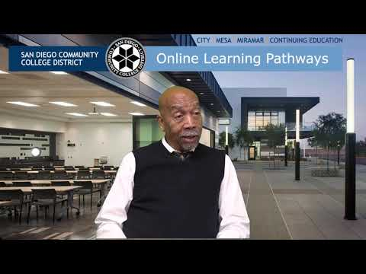
Professor Perspective Cont.

Slide 17
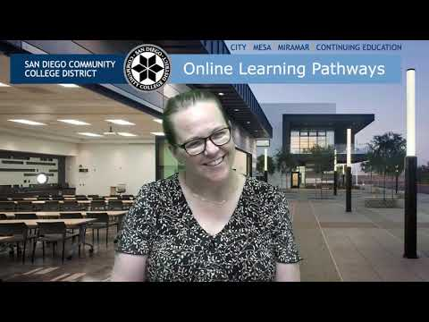
Professor Perspective Cont.

Slide 18
What’s next?
How can I use and apply humanized context in my class to facilitate a productive online environment?
Are there any resources from the SDCCD to aid me in online content?
Can I get trained to teach online content?
Is there a place where I can record videos for my lectures to create context with my students?
Inquire with students for the best times for office hours, goals, and any life related issues that may impede their online experience.
The following slides will give you more ideas about how to humanize your course through context.
Notes:
CHRIS
What can be done to fix this problem?
What can you do?
Your friends at the SDCCD OLP are here to help
We provide services like
1 on 1 appointments to go through your online courses to create effective humanized content to facilite a relationship through context
OFCP
Video studio

Slide 19
Applying and Using Context
Respect the Platform
Understand that students are using more than just desktop users.
Over 16K are using Canvas on a mobile device.
Respect the psychology of what people are doing when they are on the platform.
A 40 year old student is in a different mindset when she is on a desktop computer taking your online class vs. the 20 year old student that is taking your online class on an iPad.
Notes:
CHRIS

Slide 20
Applying and Using Context
Respect the Audience
Create course content that they can relate to
Show them how what they are learning in your course can help benefit them
Establish the value that your course can provide your student based on their career goals
Notes:
CHRIS

Slide 21
Applying and Using Context
Don’t Interrupt the Experience
If you are truly making good course content and taking into account the context in which that content will be consumed it won't interrupt the student.
Create content that is accessible across all platforms.
Add context to each file you share with your student.
What is it? Why is it important? How can they access it?
Context in which the student experiences your course for the first time matters so much. Do not roadblock them; bring them value.
Notes:
CHRIS

Slide 22
Applying and Using Context
Be Consistent and Self-Aware
Every single announcement, each piece of feedback you leave, every assignment, every file become part of your course as well as your brand. The impression the student will leave with after they have completed your course.
Every time you post you need to be laddering back to your Student Learning Outcomes.
To truly humanize your course your core story needs to be consistent and your personality needs to be consistent too.
Notes:
CHRIS

Slide 23
Support Options: Online Training Programs
Canvas-based SDCCD Online Faculty Certification Program
437 Professors were enrolled in the 2018-2019 cohort
96 Professors successfully completed that cohort
Currently 195 professors are enrolled in the 2019-2020 cohort.
Thats one fifth of all active canvas professors in the District.
This course has received positive praise from faculty that have completed it.
Submit a request for enrollment at http://bit.ly/sdccdofcp.
Notes:
CHRIS

Slide 24
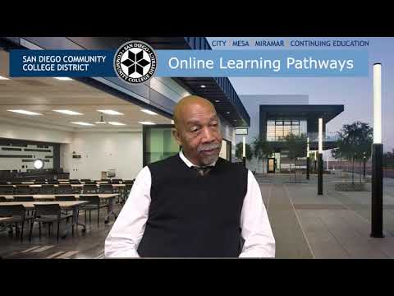
Professor testimonial

Slide 25
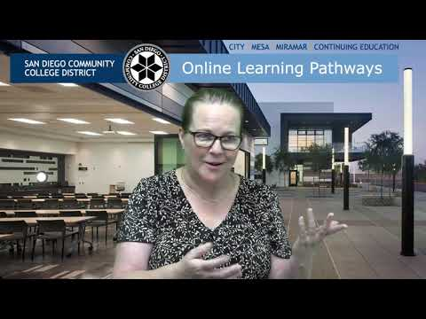
Rechelle Testimonial
Notes:
Video studio/Lab experience

Slide 26
Support Options: Face-to-Face Support
ONE-ON-ONE SUPPORT
We offer One-On-One Assistance. Either meet in our lab, or online via Zoom
We can help you with technical issues you are having with Canvas
Course design
Assistance in Humanizing your course
We can also help you establish context in your course as well
WORKSHOPS
We will have ongoing workshops throughout each semester
We also provide focused department workshops as well

Slide 27
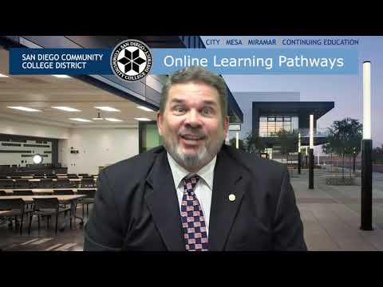
Professor Testimonial
Notes:
1 on 1 with students perspectives

Slide 28
CONTACT INFORMATION
SDCCD OLP NUMBER: 619-388-7330
CHRIS RODGERS: 619-388-7331 - crodgers@sdccd.edu
TRENTON TIDWELL: 619-388-7327 - ttidwell@sdccd.edu
PETER TEA: ptea@sdccd.edu
CANVAS FACULTY SUPPORT: 1-844-612-7422
CANVAS STUDENT SUPPORT: 1-844-612-7421
We encourage you to contact us with any questions you may have or to schedule an appointment.
Notes:
CHRIS

