Slide 1



DE SUMMIT
October 4, 2024

Slide 2
SDCCD OLP Faculty Resources
Online Learning Pathways Team

Slide 3


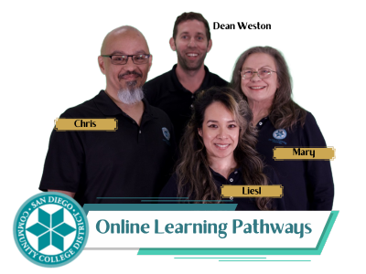
Online Learning Pathways Team
Dean Brian Weston
Liesl Boswell, Instructional Design Supervisor
Chris Rodgers, Instructional Design Coordinator
Peter Tea, Systems Analyst
Mary Kingsley, Secretary

Slide 4

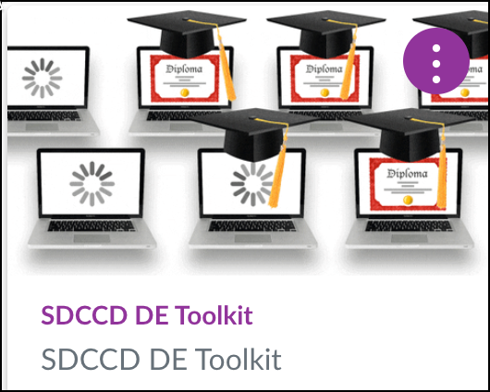
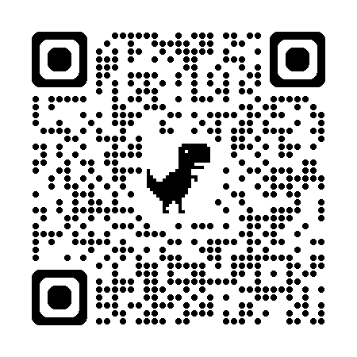
SDCCD DE Toolkit
CAN DO: For Busy Educators Series
We'll cover the essentials of using Canvas, along with some of its special features to help you streamline your teaching and enhance student engagement. Perfect for those short on time but eager to maximize their Canvas skills. Join us and discover what Canvas CAN DO for you!
Ed-Venture Series
This workshop series is all about exploring innovative teaching practices to boost student learning and make your courses a hit with students. Whether you're looking to refresh your approach or try something new, these sessions are packed with creative strategies and practical tips. Join us and take your teaching to the next level!
Za-Za Zoom Series
Join us for a series of workshops where you'll learn how to harness the power of Zoom to elevate your teaching. From designing interactive sessions to creating a strong learning community, we'll show you how to make the most of Zoom's features to engage your students like never before. Don't miss out!

Slide 5
Workshop Types
Click-A-Long
This hands-on session lets you work on your course in real-time while following along with guided instructions. Bring your laptop, and as we explore features and strategies, you'll click along and apply them directly to your course. It’s the perfect way to learn by doing and leave the workshop with tangible progress!
Demo
We'll be showcasing new applications and processes that can elevate your teaching experience. You'll get a firsthand look at how these tools work, with step-by-step guidance on how to integrate them into your own courses. It's a great opportunity to see the latest innovations in action and ask questions along the way!
Community/Panel
This is your chance to engage with fellow educators in a collaborative space where we’ll discuss key topics, share insights, and explore different perspectives. Whether you have questions, ideas, or just want to listen in, this workshop is all about open dialogue and learning from each other. Everyone’s voice is welcome!

Slide 6










OLP-Supported Software & Services

Slide 7
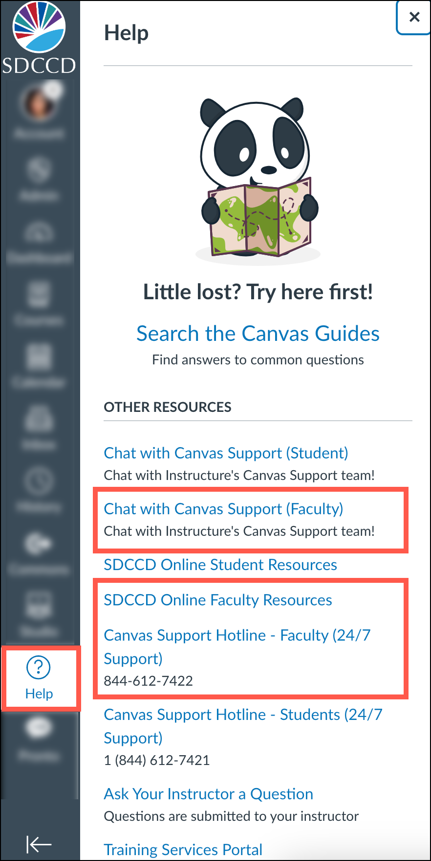


Who You Gonna Call?
Canvas woes? Contact Canvas Support first!
Get help in faster, in minutes!
Canvas
Problems

Slide 8
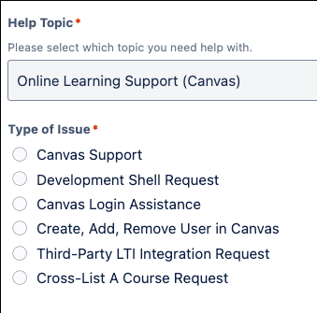
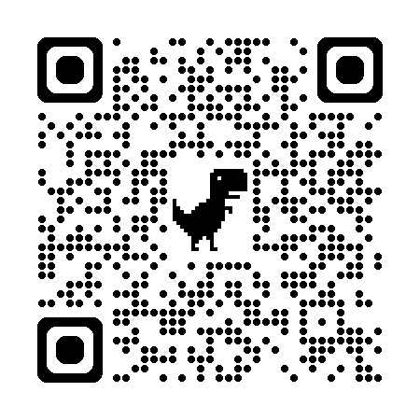
Faculty Support Form
Canvas Support (Instructional Design support)
Development Shell Request
Canvas Login Assistance
Create, Add, Remove User in Canvas
Third-Party LTI Integration Request
Cross-List A Course Request

Slide 9
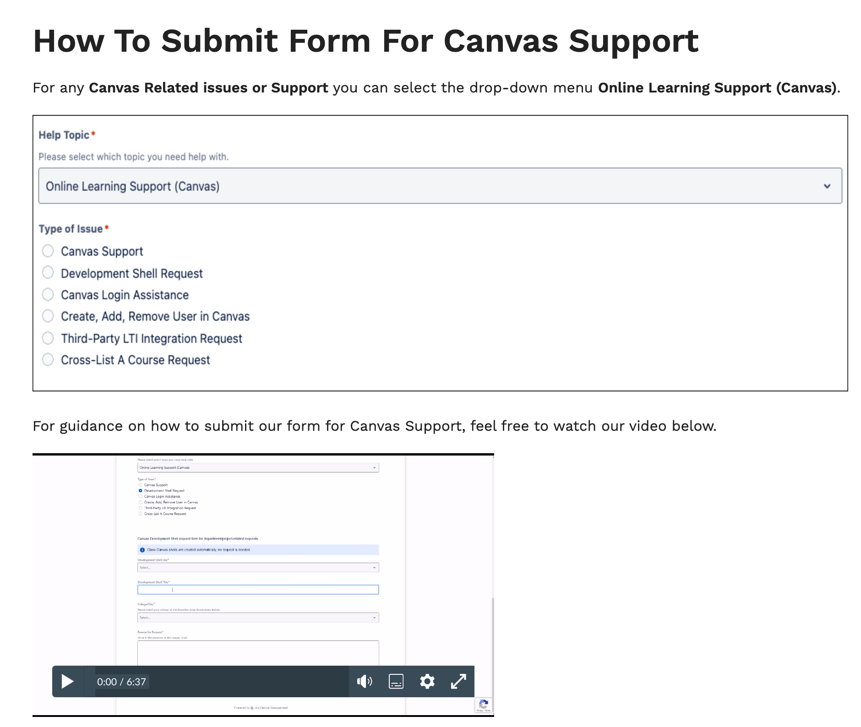
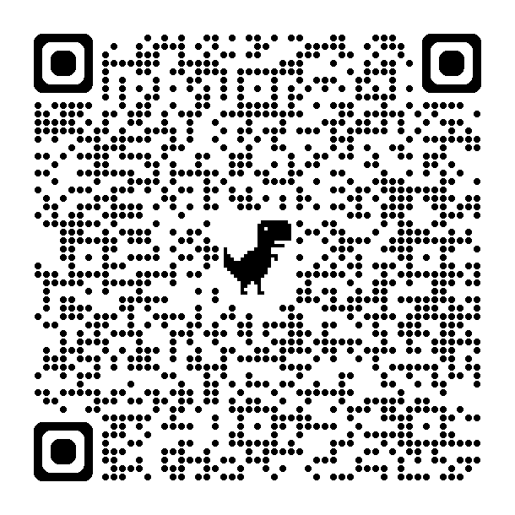
How to Submit Guidance
Canvas Support (Instructional Design support)
Development Shell Request
Canvas Login Assistance
Create, Add, Remove User in Canvas
Third-Party LTI Integration Request
Cross-List A Course Request

Slide 10

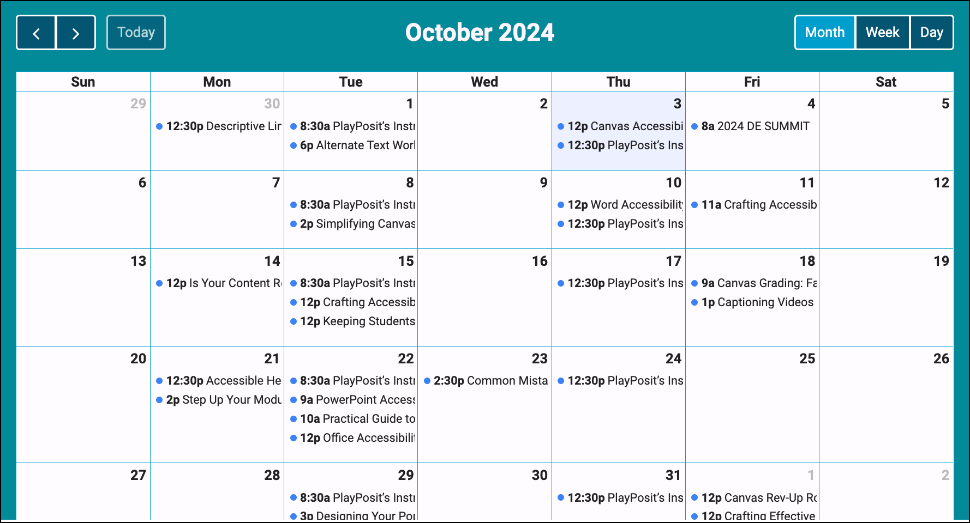
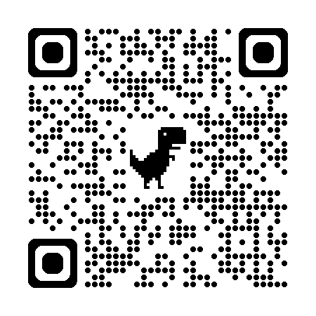
SDCCD Online Pathways PD Calendar

Slide 11
Upcoming OLP Workshops
  In mid-October, we are offering two exciting workshops to help you enhance your online teaching experience. These sessions focus on making Zoom interactions more engaging and improving your grading efficiency in Canvas. Don’t miss out on these valuable opportunities!
  Za-Za Zoom Series: Interactive Zoom – Keeping Students Hooked & You Popular
  Date: October 15, 12:00 - 1:00 PM
  Description: Get ready to transform your online teaching with Zoom! This workshop will teach you how to use Zoom’s features to create interactive and engaging virtual classes that your students will love. Learn tips and tricks to keep your students engaged and master the art of breakout rooms for group activities.
  Zoom Link: https://sdccd-edu.zoom.us/j/87160774779?pwd=1jg6dcuDh7QykLheekOjak5iz5eEAE.1
  CAN DO: For Busy Educators Series – Canvas Grading: Fast and Easy Methods
  Date: October 18, 9:00 - 10:00 AM
  Description: This workshop is your ticket to becoming a Canvas SpeedGrader pro! Learn how to navigate SpeedGrader, provide effective feedback, and manage grades efficiently, leaving you more time to focus on teaching and inspiring your students.
  Zoom Link: https://sdccd-edu.zoom.us/j/85790153386?pwd=qB1BUbJaFWekkZbBGNq81Wj0tKvP6J.1

Slide 12
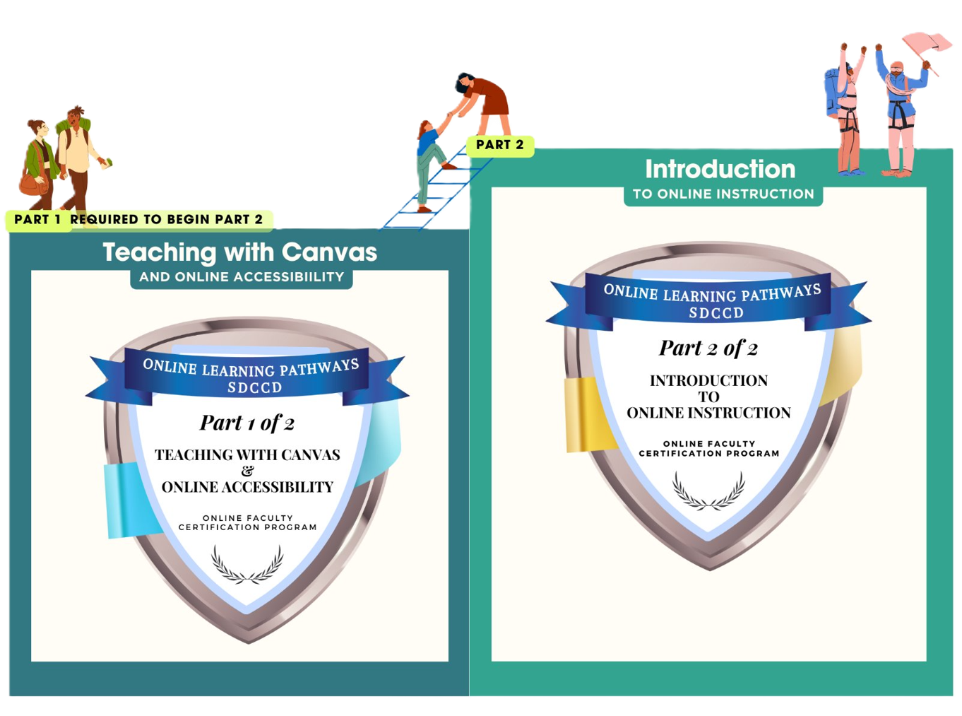
OFCP
  Online Faculty Certification Program

Slide 13

THANK YOU
Contact us at
dlforisptolp@sdccd.edu

