Slide 1



DE SUMMIT
October 4, 2024
Notes:
https://www.sdccd.edu/departments/instruction/online/faculty/de_summit_2024.aspx

Slide 2
Student Online Readiness
Online Learning Pathways Team

Slide 3

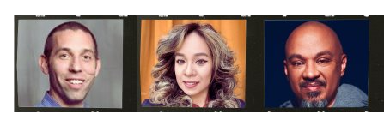
About Online Learning Pathways (OLP)
Dean Brian Weston
Liesl
Instructional Design Supervisor
Chris
ID Coordinator

Slide 4


SPOT
  Student Prep & Online Training
  1-1.5 hour
  Online readiness
    knowing how to use technology
    managing your own time
    communication well online
Notes:
Student online readiness is very important in today's world of education, where more and more learning happens online.
As online classes become more common, it's crucial to know if students are ready for this type of learning.
Being ready for online learning means having skills like knowing how to use technology, managing your own time, and communicating well online.
Studies show that students who don't have these skills often struggle.
They might not participate as much in class, get lower grades, or even drop out. The COVID-19 pandemic made this even clearer when many students had to suddenly switch to online learning without being prepared.
Students who are well-prepared for online learning often become better at thinking critically and solving problems. This helps them learn better overall. By helping students get ready for online learning, we not only help them do better in school but also make education better and more inclusive for everyone.

Slide 5


Student Takeaways
The importance of cultivating a positive mindset
  The key skills to navigate the online classroom
  Locate local resources
  Study habits, time management, and organizational skills for academic success in the online environment
Notes:
Hard/soft skills

Slide 6
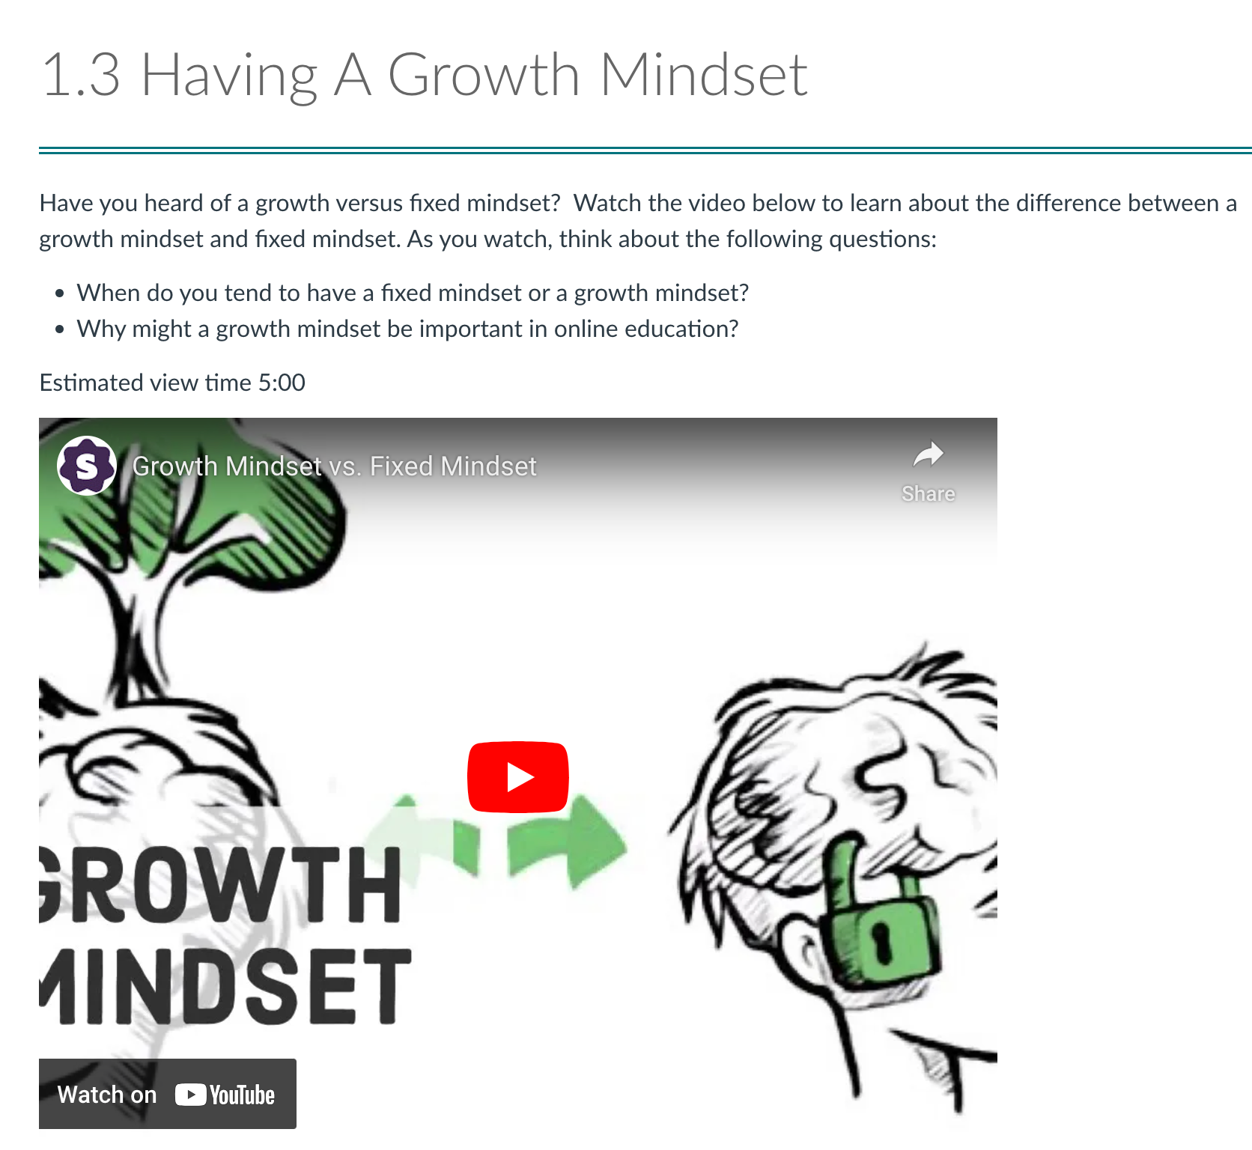
Improving
Success

Slide 7
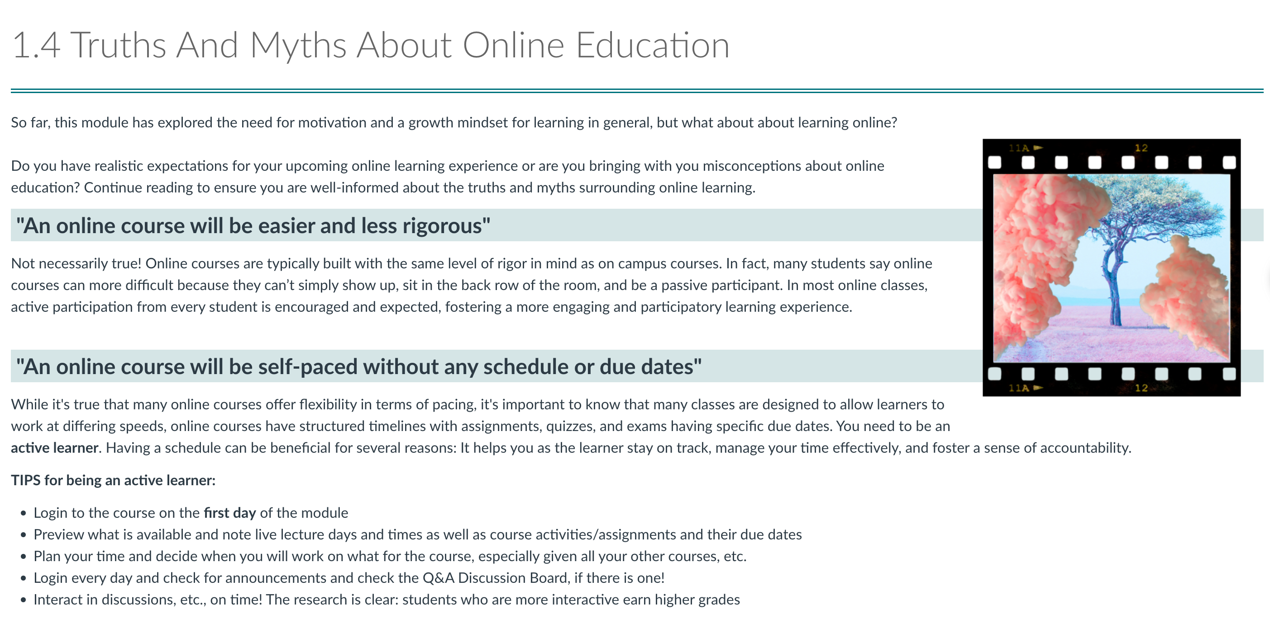
Back to Life, Back to Reality

Slide 8
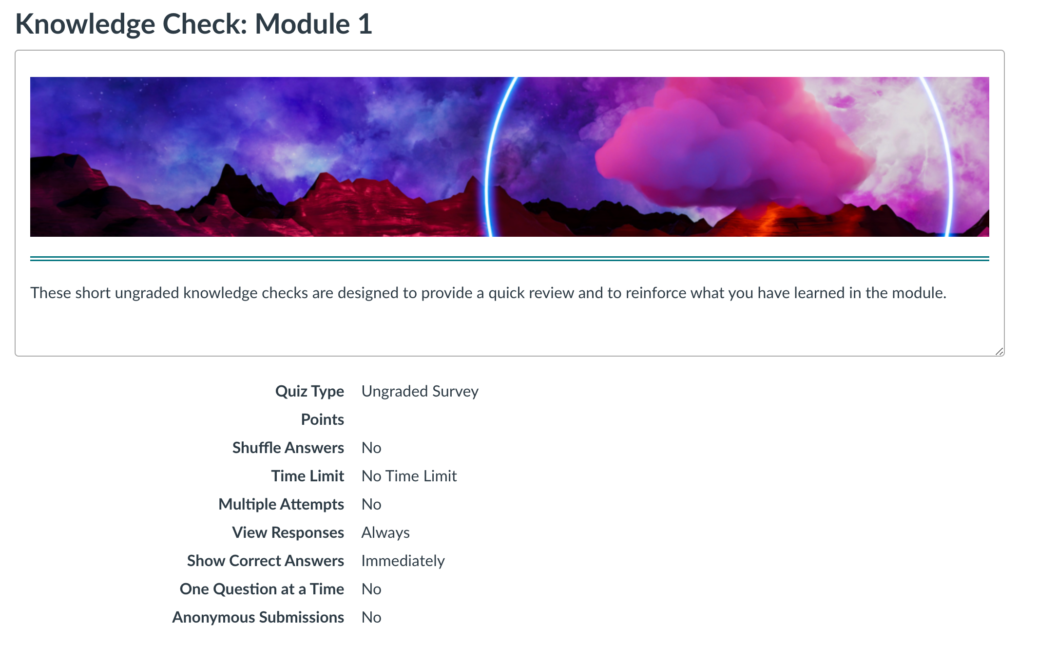
Knowledge Check

Slide 9
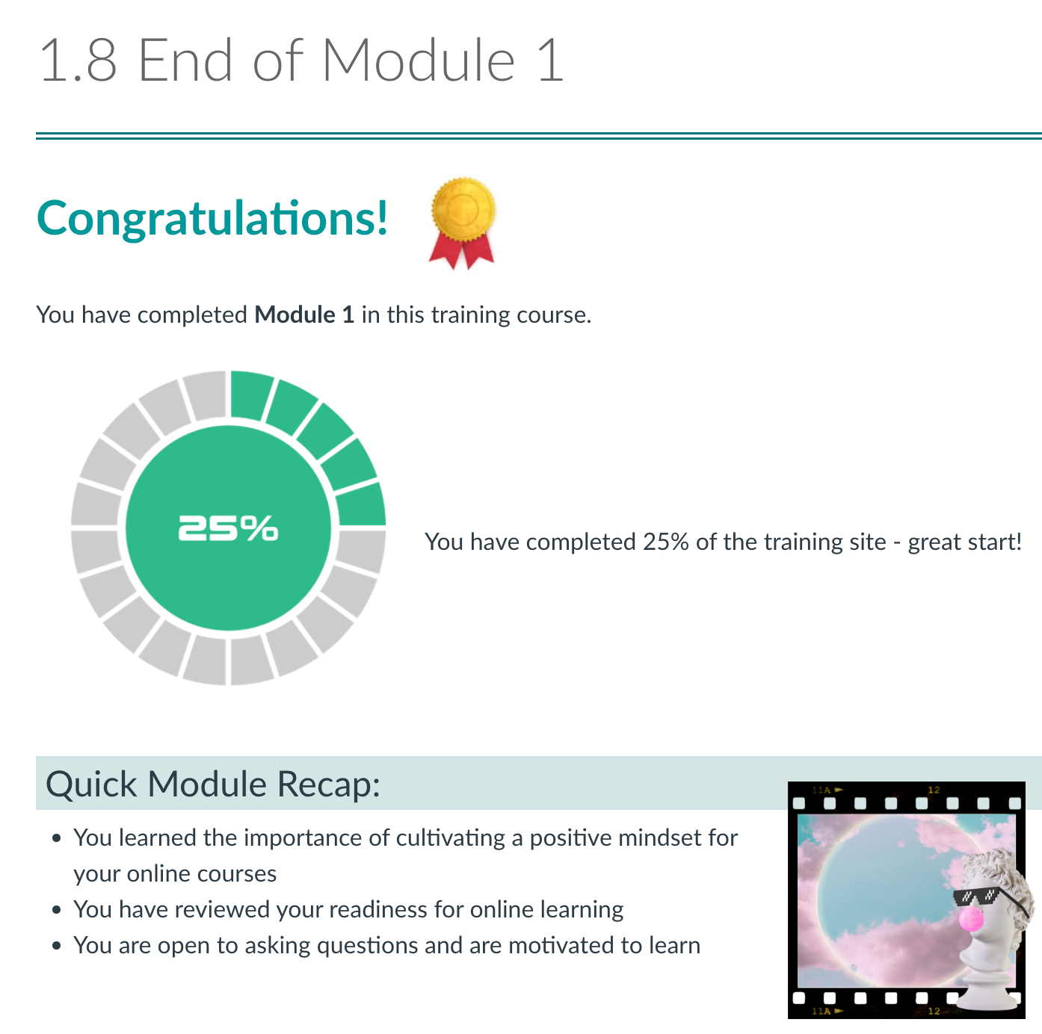
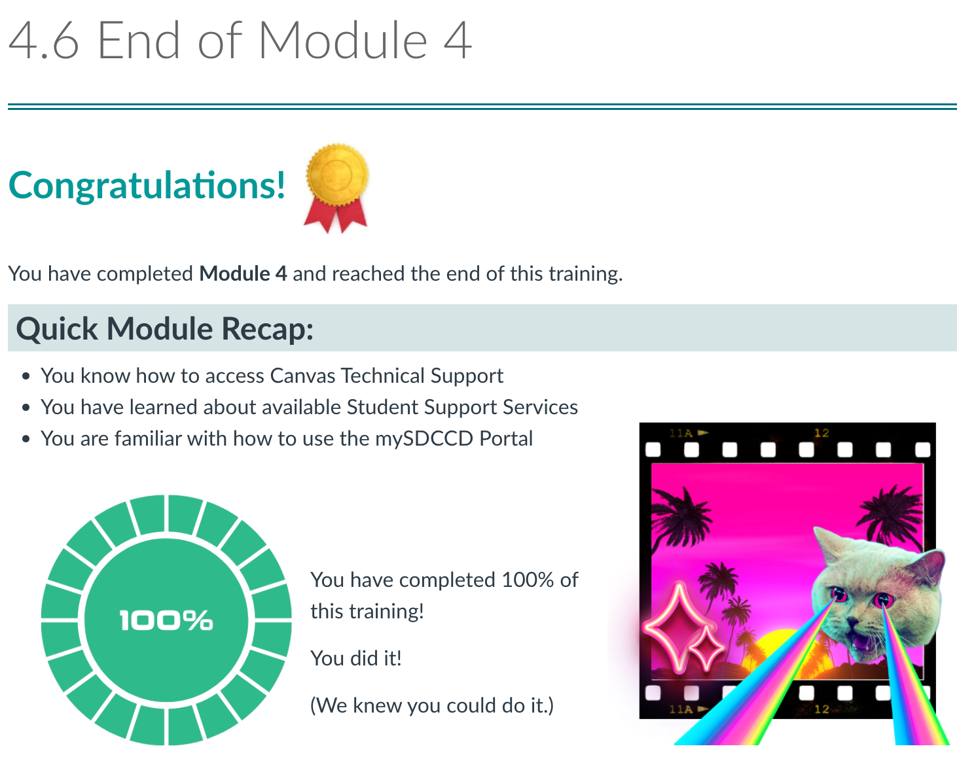
Progress
& Recaps

Slide 10
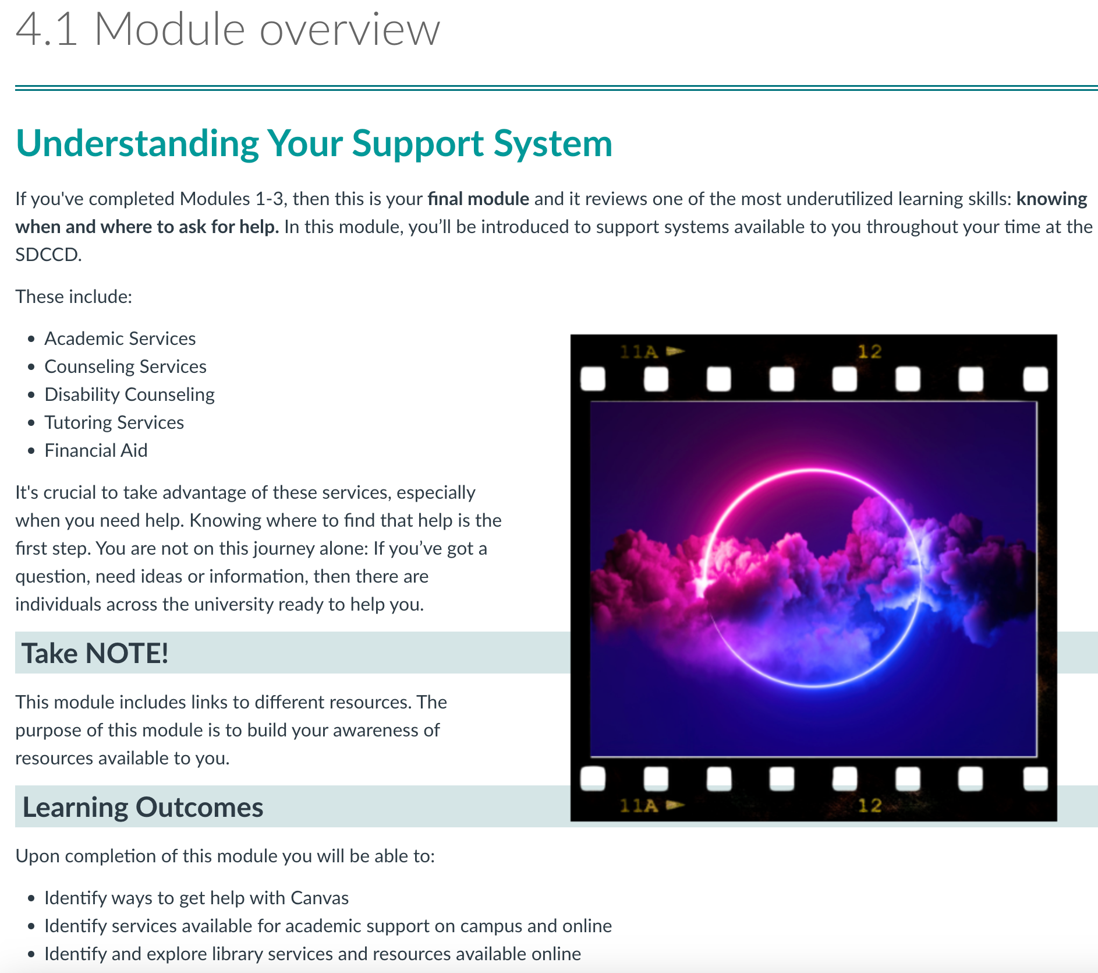
Resources

Slide 11


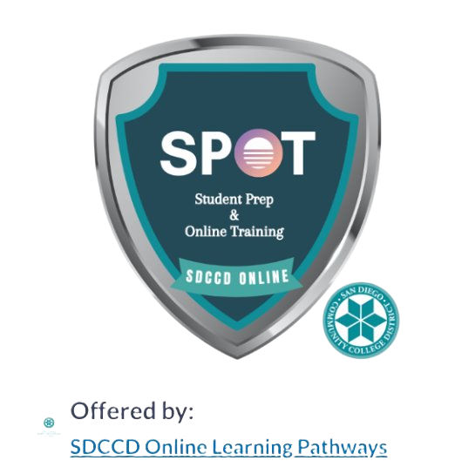
Verify Real Students with the Student Badge
Notes:
Fraudulent students, also known as "ghost students", are fake identities or bots used to steal money from colleges and the government

Slide 12

THANK YOU
Contact us at
dlforisptolp@sdccd.edu

