Slide 1



DE SUMMIT
October 4, 2024

Slide 2
Surfing the OER Wave of Interaction
Madeline Button

Slide 3


About
Madeline Button
OER Analyst
SDCCD Community Funding Grant
Native San Diegan
Experience in education since 2018
Working with SDCCD since 2022
Support transition of online courses to using OER
Technical support, accessibility checks, licensing checks
Finding OER ⭤ Creating OER
Exploring new OER options

Slide 4


Agenda
What is OER
Where to Start
Integrating OER in Canvas
Interactive OER: H5P

Slide 5

OER:
Open Educational Resources
  What is OER?
  Materials for teaching, learning, research, etc.
  Free
  Open-licensed
  What does it look like?
  Textbook ⭤ Interactive H5P
  Broad ⭤ Discipline specific

Slide 6

Investing Time in OER
Adopt
Exploration
Integration
⭤
Adapt
Exploration
Quality check
Integration
Low
Quality Check
High
Create
Modification
Development
Review, Edit
Publication

Slide 7


Use Your Resources!
  Librarians
    Campus-specific
    Ask about LibGuides!
  District resources in Canvas
    SDCCD DE Toolkit
    SDCCD Open Educational Resources
  Canvas resources
    SDCCD Resources, Canvas Community, YouTube
  Licensing
    SDCCD Resources, Creative Commons

Slide 8
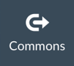
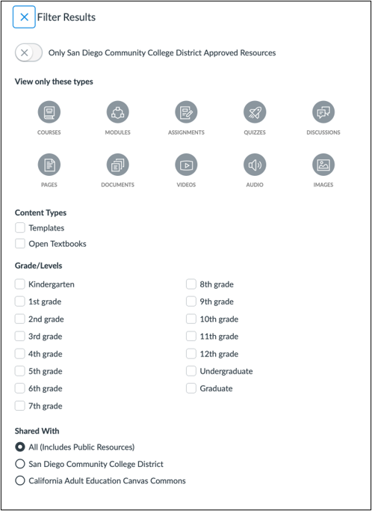
Where to Start: Exploration
Canvas Commons:
Find Resources
  Courses, modules, quizzes, etc.
Import Resources
Share Resources
  Publicly, privately, or within SDCCD
Closer look and best practices:
  SDCCD DE Resources
  Module 11: Canvas Commons & Free Adaptable Layouts

Slide 9

Where to Start: Exploration
OER Repositories: Public Digital Libraries
Search by discipline, material type, license (CC)
  OER Commons
  MERLOT
  OASIS
  ASCCC OER
Mason OER Metafinder (MOM)
  Searches across 22 OER collections at once
Markus Büsges (leomaria design) für Wikimedia Deutschland e. V.,
CC BY-SA 4.0, via Wikimedia Commons

Slide 10
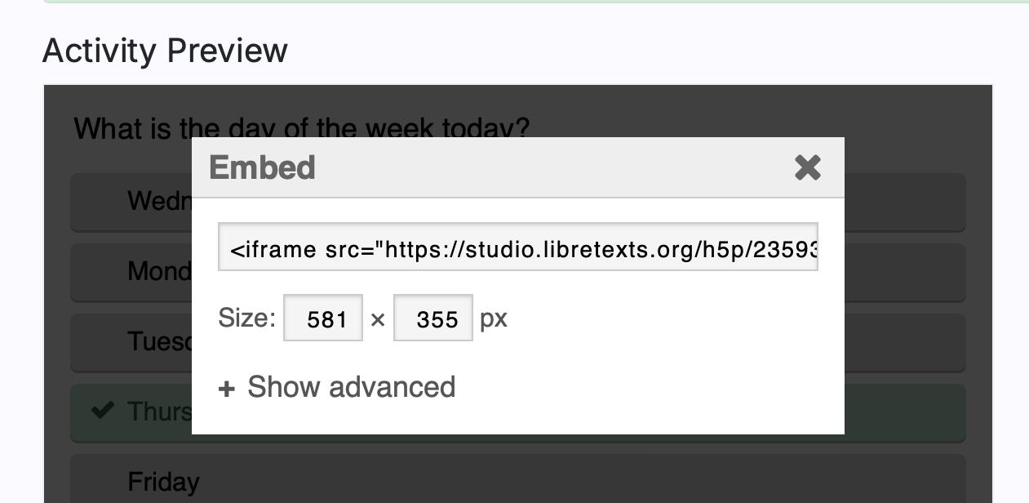
Integration into Canvas
Canvas Commons
Seamless download/import
Textbooks
Link out to source – always add context/instructions
Download/Import to LMS
Embedding
Canvas editor menu → Insert → Embed (paste code)
Examples:
  H5P Activity
  YouTube video
  Google poll
  Interactive lab

Slide 11
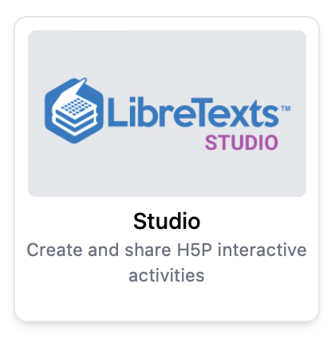
Interactive OER: Using H5P
What is H5P?
Html-5-Package: A plugin tool that helps produce and run interactive content within an LMS
Examples:
  Sample Questions Collection
  All H5P Examples
LibreTexts / LibreOne
Offers 'Studio' feature with H5P library and builder

Slide 12


Finding and Using H5P
In the Library:
Search Collections and/or individual activities
Search by Subject, Author, Keyword, and/or H5P type
  Broad: 'Chemistry' (1605 results)
  Narrow: 'Arabic' + 'Dialogue Cards' (26 results)
Check License type
Integration in Canvas:
All activities embeddable
Self-assessments
  For graded assignments, explore ADAPT
Closer look and best practices:
  SDCCD DE Resources
  Surfing the H5P Wave: Ride the Future of Interactive Learning

Slide 13

Questions?

Slide 14
THANK YOU
Contact Me:
mbutton@sdccd.edu
Schedule A Session:
https://outlook.office365.com/owa/calendar/CFGMeeting@sdccd.edu/bookings/

