Slide 1



SDCCD Distance Education Summit
October 4, 2024

Slide 2

Agenda
Welcome
DE Summit Schedule
Be: Students
Belong: Modality
Become: Success

Slide 3

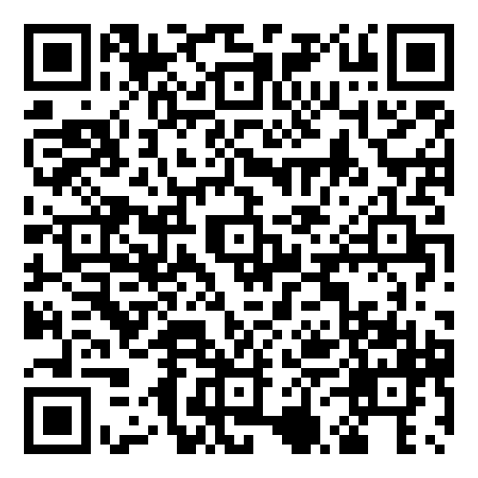
Welcome
Online Learning Pathways Website
Presentations
Recorded Sessions
Support
Wi-Fi
Zoom- Moderated
Welcome
Sign In
Work Raffle

Slide 4


Thank you
Online Faculty Mentors
Faculty
Online Accessibility Mentors
Educational Services
Institutional Innovation and Effectiveness
Information Technology
Custodians
Facilities
Online Learning Pathways
& You

Slide 5

Schedule
Time | Title | Speaker
8-8:45 | Breakfast networking
8:45-9 | Opening Remarks | Dean Weston
9-10 Keynote | Intentional Tech: Principles to Guide the Use of Educational Technology in College Teaching | Derek Bruff, Ph.D
10-10:15 | Break
10:15-10:45 | Surfing the H5P Wave: Ride the Future of Interactive Learning! | Madeline Button
10:45-11 | Student Prep & Online Training (SPOT) | Liesl Boswell , Chris Rodgers
11- 12pm | Ethical Challenges of AI in Education - Integrating AI into Education / Online Learning | Professor Gurganus and Professor Gomez, Faculty Specialists for Emerging Technologies (SDCCD II&E)
12-12:30 | Lunch
12:30-12:50 | SDCCD OLP Resources (12:30pm) + (12:45pm Pronto) | Online Learning Pathways, Sydney Duston
12:50-1 | Break
1-1:40 pm | Faculty Showcase | Online Mentors
1:40-1:50 | Bridging the Gap: Enhancing Student Experience | Dean Devore
1:50-2 | Wrap Up
https://www.sdccd.edu/departments/instruction/online/faculty/de_summit_2024.aspx

Slide 6
SDCCD DE Overview
2023-24, just under half of enrollments districtwide were online
Over 57,000 students enrolled in an online or partially online course in 2023-24 across SDCCD
SDCCE, students were more than twice as likely to take a class online in 2023-24 than before the pandemic
About half of the students who attended each credit college in 2023-24 also attended another credit college

Slide 7
Students
Notes:
2023-24 Black 8671 Asian 11684 Filipino 4925 Latinx 42666 Mutli-Ethnicity 8751 Native American 228 Pacific Islander 481 Unknown 1243 White 30021

Slide 8
DE Modality Options
Online Live- All classwork is conducted online with a requirement for real-time/live meetings.
Fully Online- All classwork is conducted online without a requirement for real-time/live meetings.
Partially Online- Some required class meetings will be conducted on campus. The remainder of the class will be online.
HyFlex- Students can join the scheduled class session online or on-campus based on student preference. The rest of the classwork is conducted online.

Slide 9
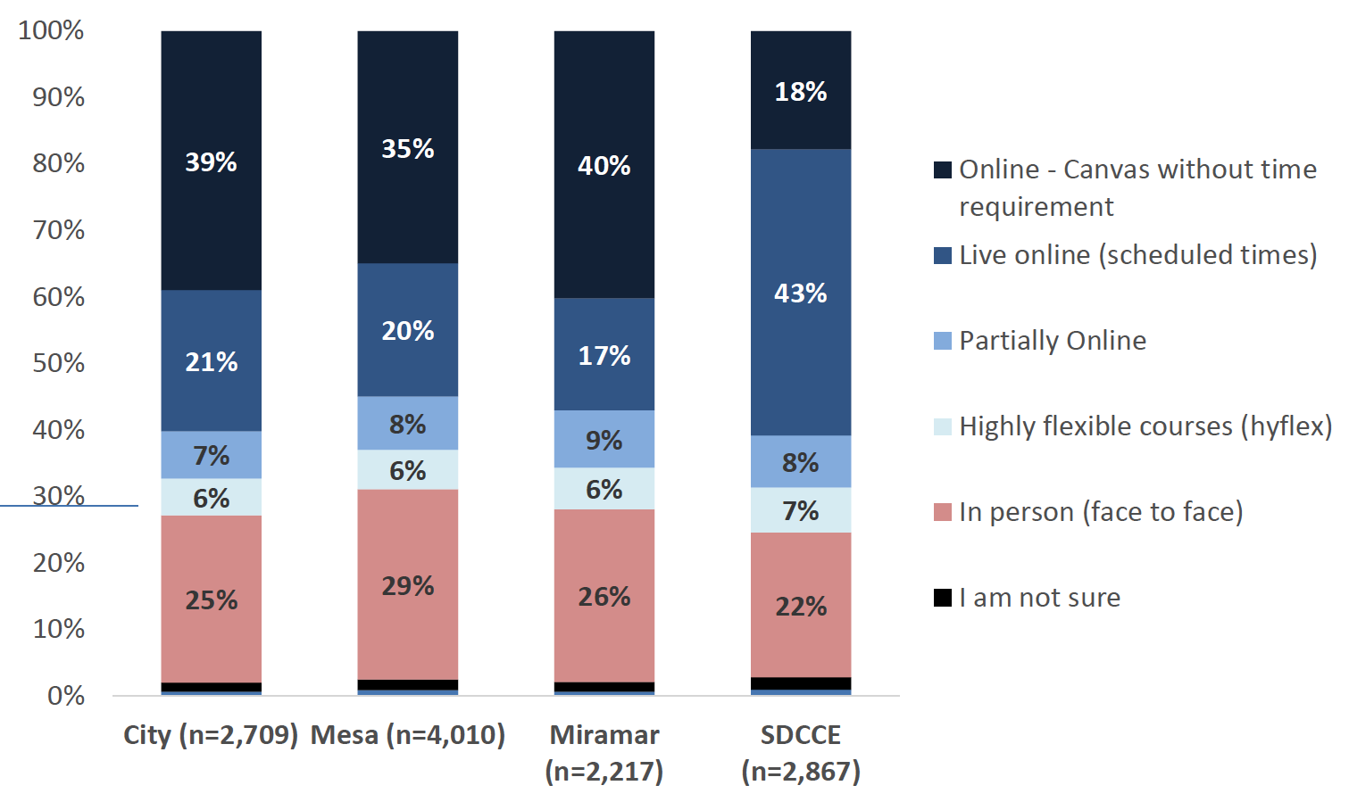
Course Preferences '21
Online Enrollments 2023/24:
48% City, Mesa, and Miramar Colleges
54% College of Continuing Education

Slide 10

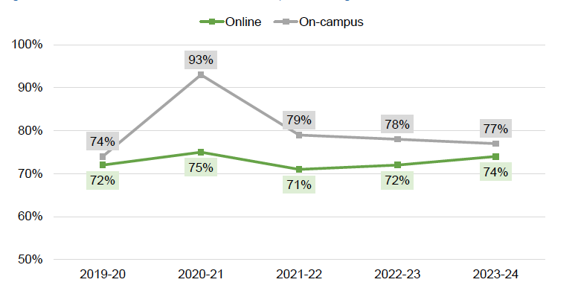
Success Rates in Transfer Level Coursework, Credit
Note 1. Includes enrollments in transfer level coursework. Excludes tutoring and credit-by-exam. Excludes courses taught both on-campus and online.
Note 2. “Online” is an aggregation of fully online (asynchronous), online-live (synchronous), and Hyflex courses (in which students may attend up to 100% of instruction online).

Slide 11
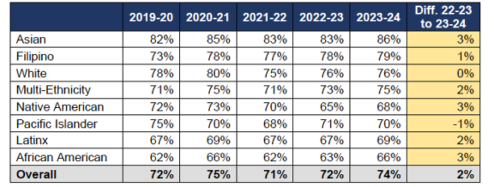
Credit Online Success Rates

Slide 12

Trends
Credit online enrollments in 2023-24 were mostly in Fully Online (asynchronous) sections (93% at the credit colleges), while SDCCE had more Online-live (synchronous) enrollments
Gaps in online success rates remain largest for Native American, Latinx, and African American
Hyflex courses are less common but are an emerging modality with potential for growth
Success rates for fully online and online-live (synchronous) courses are generally comparable

Slide 13


Supporting Equitable Learning
CVC Course Exchange
Peer Online Course Review
CVC Teaching College Implementation
DE Professional Development
Notes:
2023-24 Black 8671 Asian 11684 Filipino 4925 Latinx 42666 Mutli-Ethnicity 8751 Native American 228 Pacific Islander 481 Unknown 1243 White 30021

Slide 14

Significant demand from students for distance education options
Gap of student success and retention online vs on campus is narrowing
DE success rates maintained with significant increase of courses
DE enables access to courses needed to meet educational goals faster
“The New Norm:
DE is now Mainstream”

Slide 15
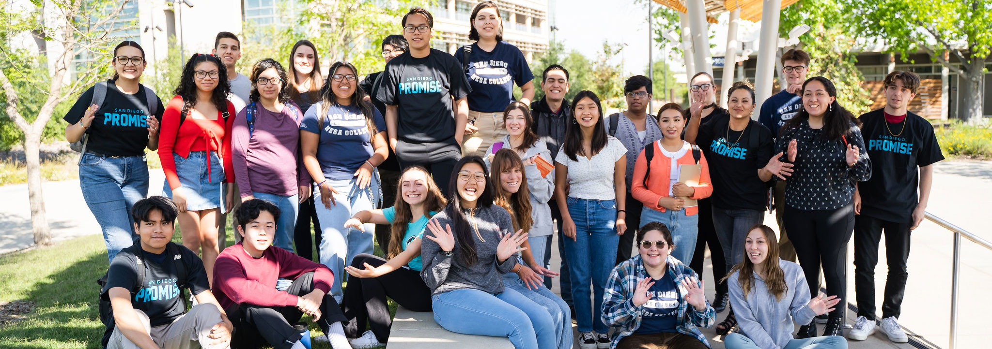

Slide 16
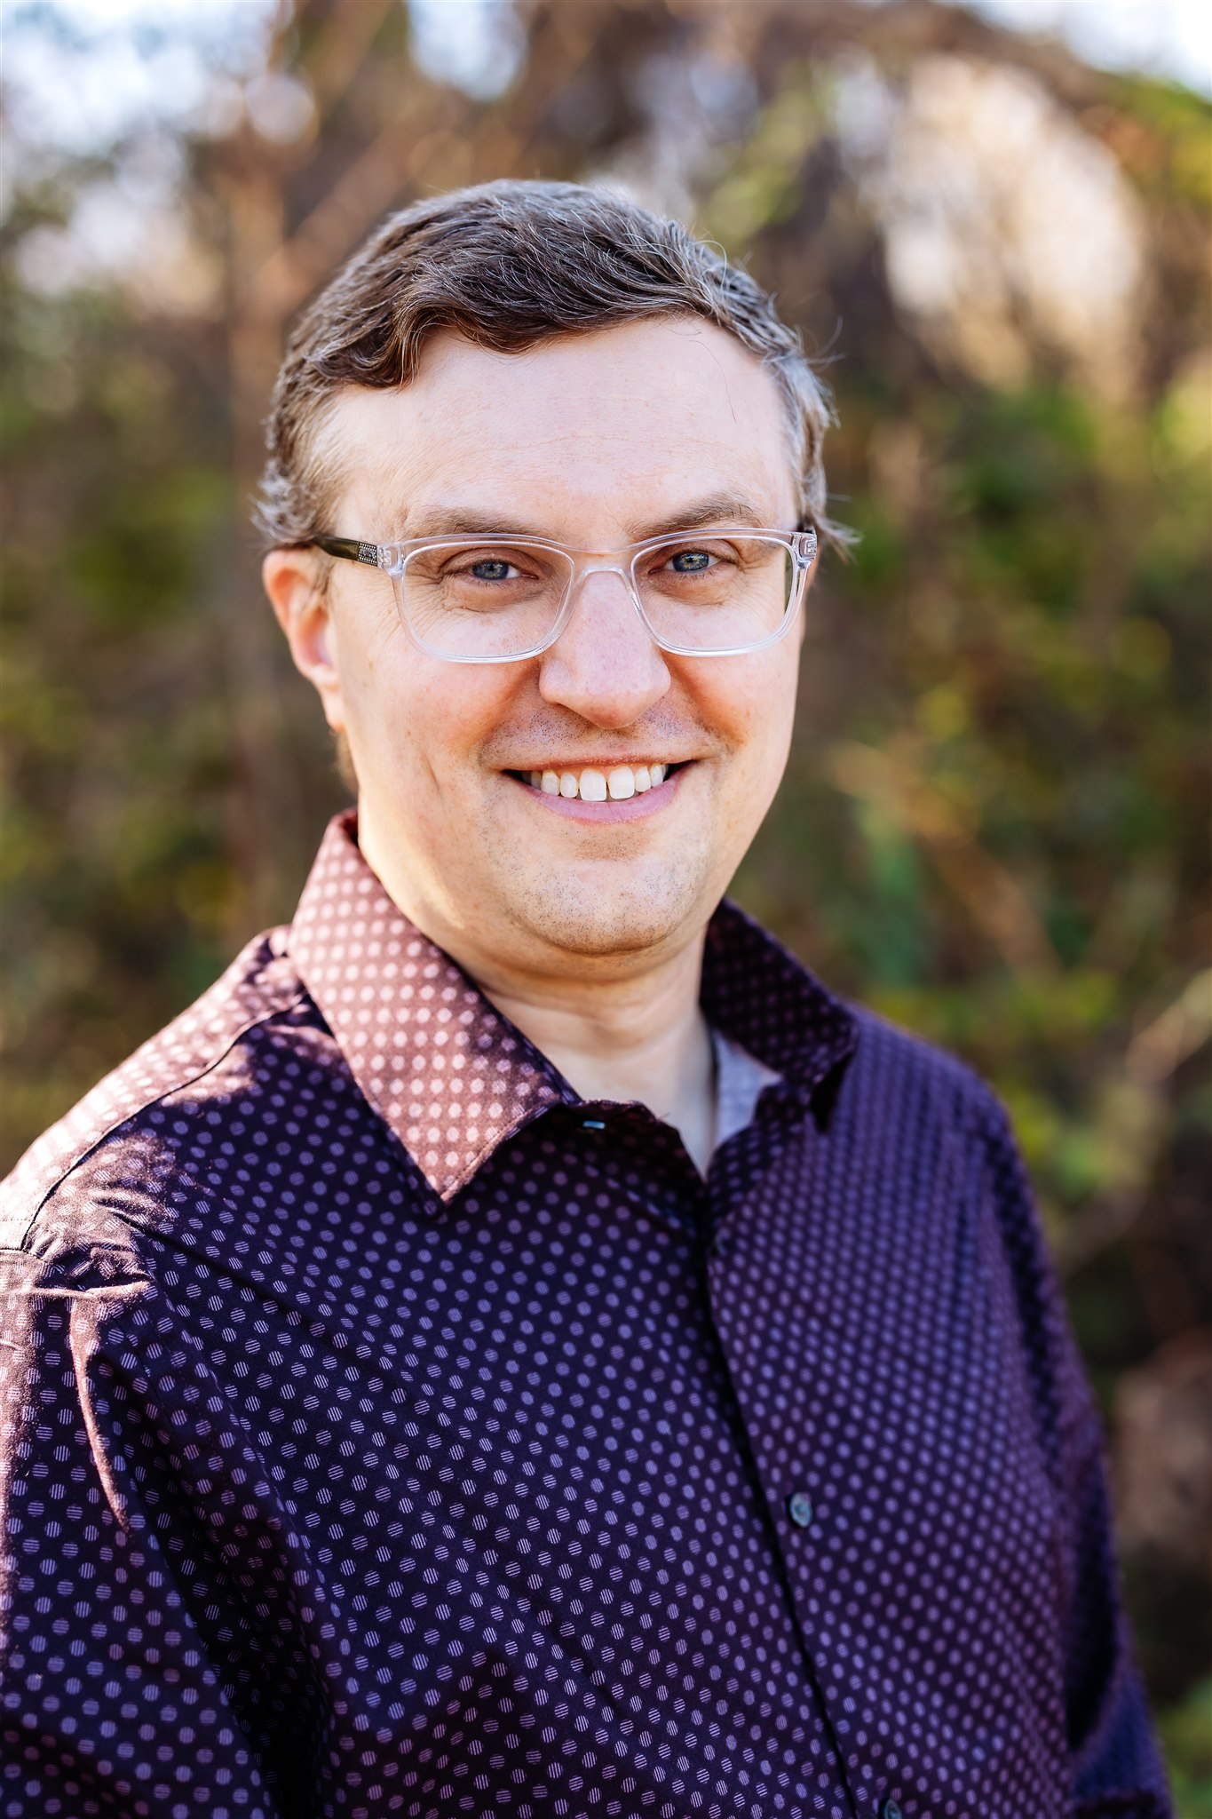

Derek Bruff, PhD
Notes:
Derek Bruff is an educator, author, and higher ed consultant. He directed the Vanderbilt University Center for Teaching for more than a decade, where he helped faculty and other instructors develop foundational teaching skills and explore new ideas in teaching. Bruff consults regularly with faculty and administrators across higher education on issues of teaching, learning, and faculty development, and he is an associate director at the Center for Teaching Excellence at the University of Virginia for the 2024-2025 academic year.
Bruff has written two books, Intentional Tech: Principles to Guide the Use of Educational Technology in College Teaching (West Virginia University Press, 2019) and Teaching with Classroom Response Systems: Creating Active Learning Environments (Jossey-Bass, 2009). He writes a weekly newsletter called Intentional Teaching and produces the Intentional Teaching podcast. Bruff has a PhD in mathematics and has taught math courses at Vanderbilt and Harvard University.

