Slide 1





DE SUMMIT
October 4, 2024

Slide 2


Using Pronto for Classroom Communication
Sydney Dutson

Slide 3
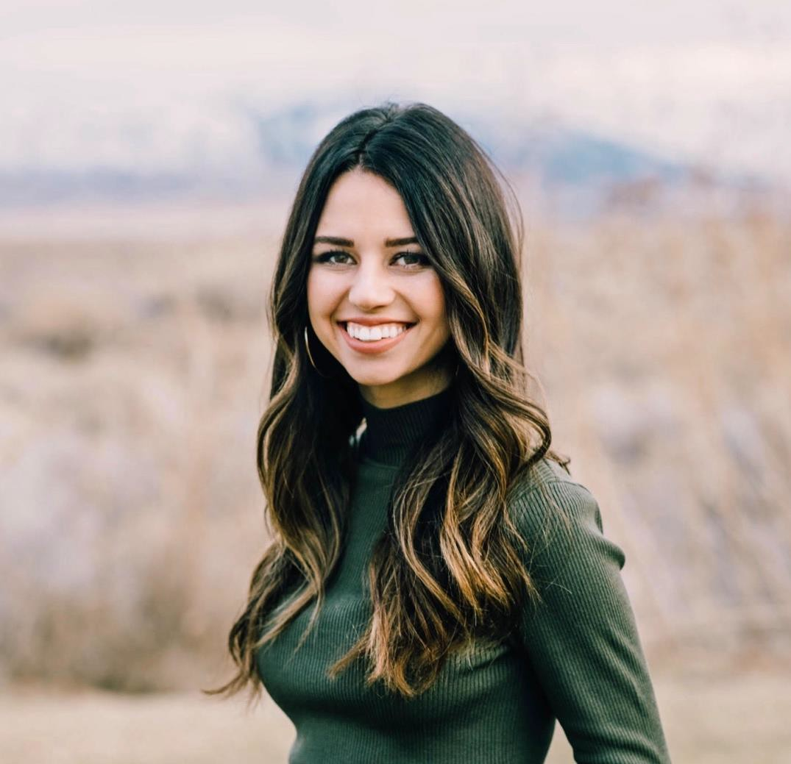
About
Sydney is a Customer Success Manager at Pronto. Sydney has been at Pronto for exactly three years to the date. Prior to joining Pronto, she was an elementary school teacher and taught for 5 years. Understanding the importance of communication and engagement in the classroom, she is ready and excited to help implement Pronto as a communication tool in your classes as she is SDCCD's dedicated CSM. Please reach out to Sydney for additional help and individual support at sydney@pronto.io.

Slide 4
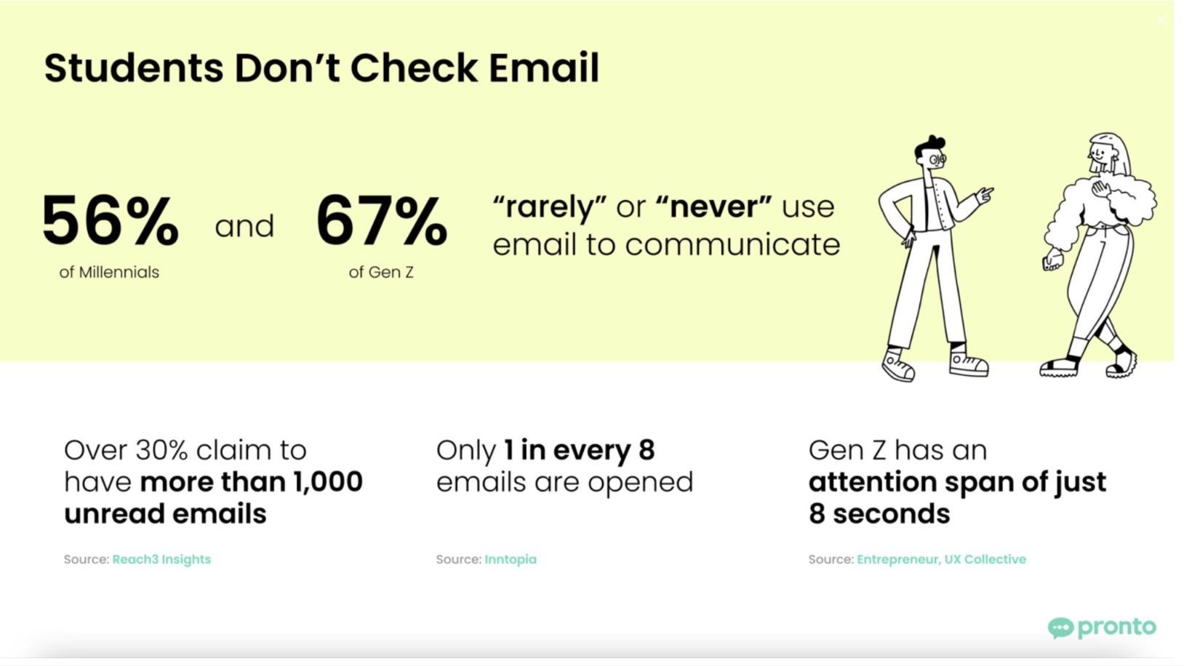

Slide 5
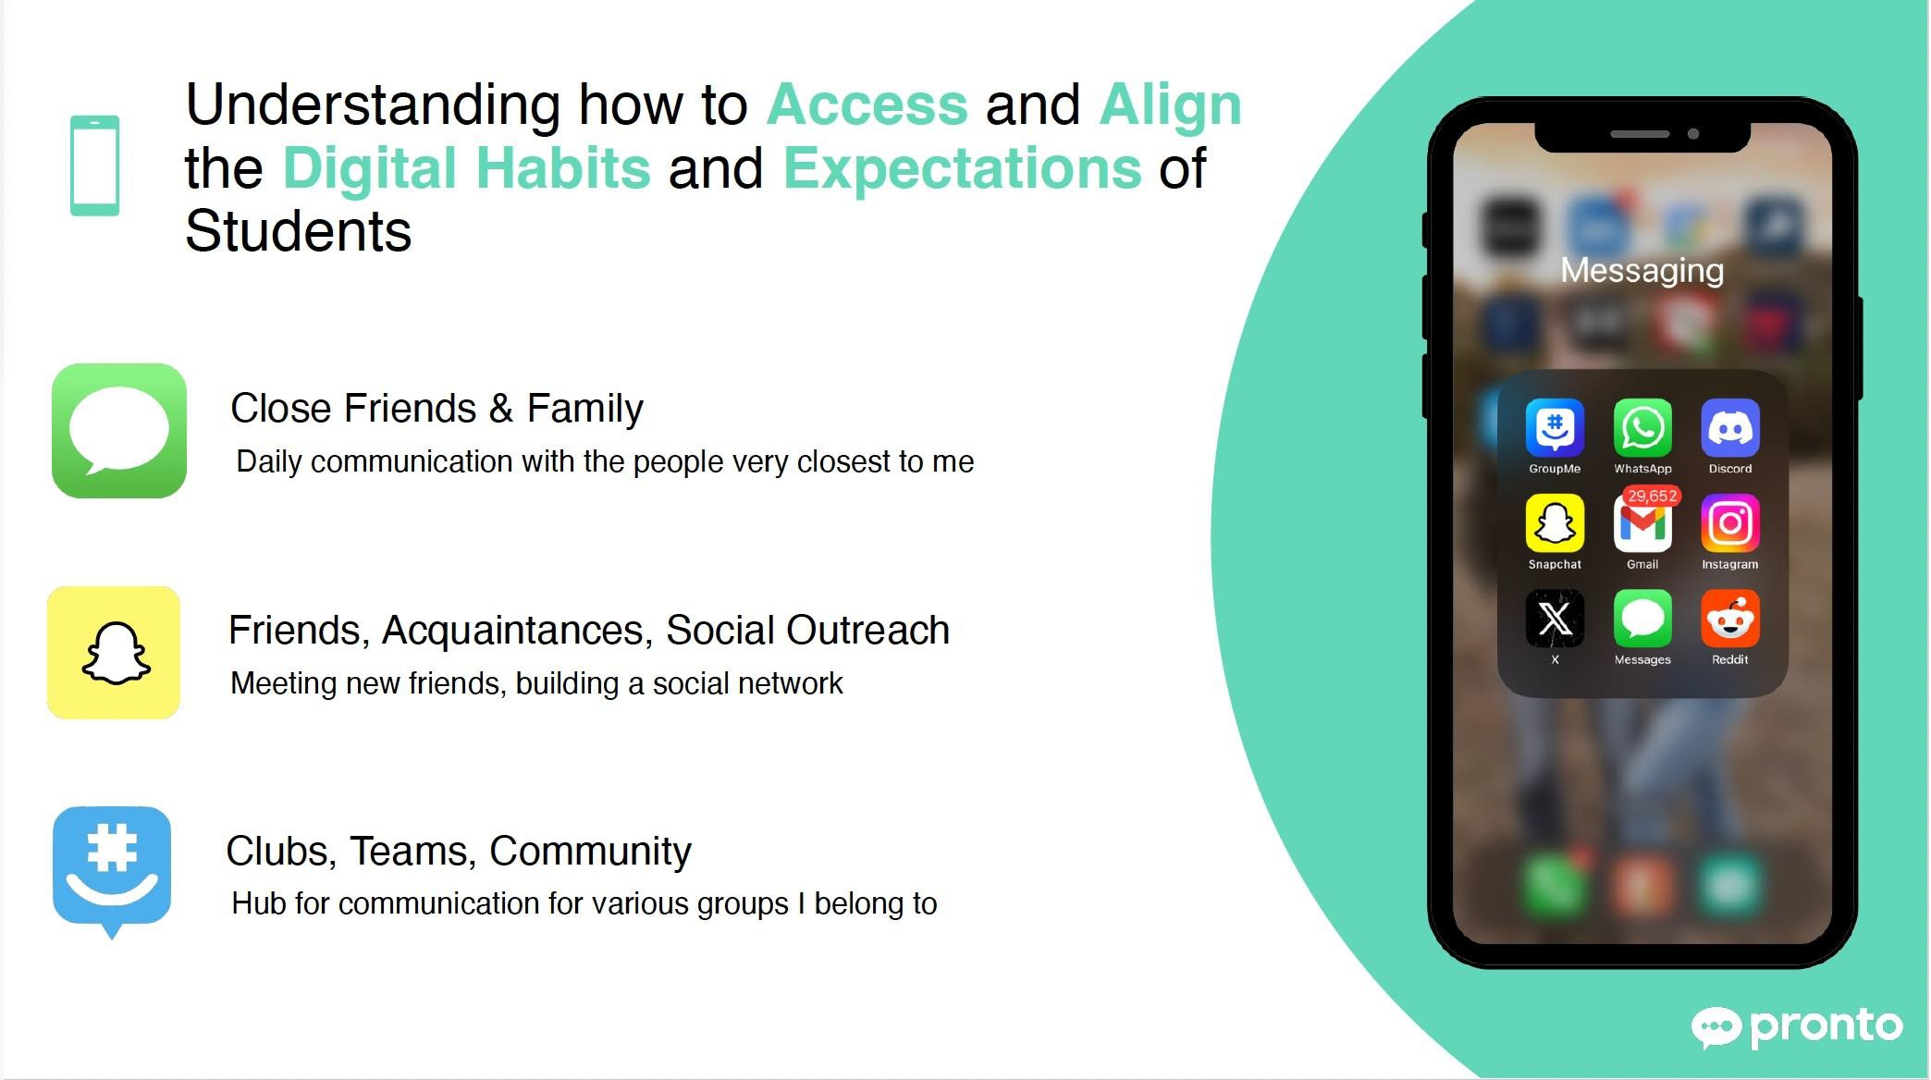

Slide 6
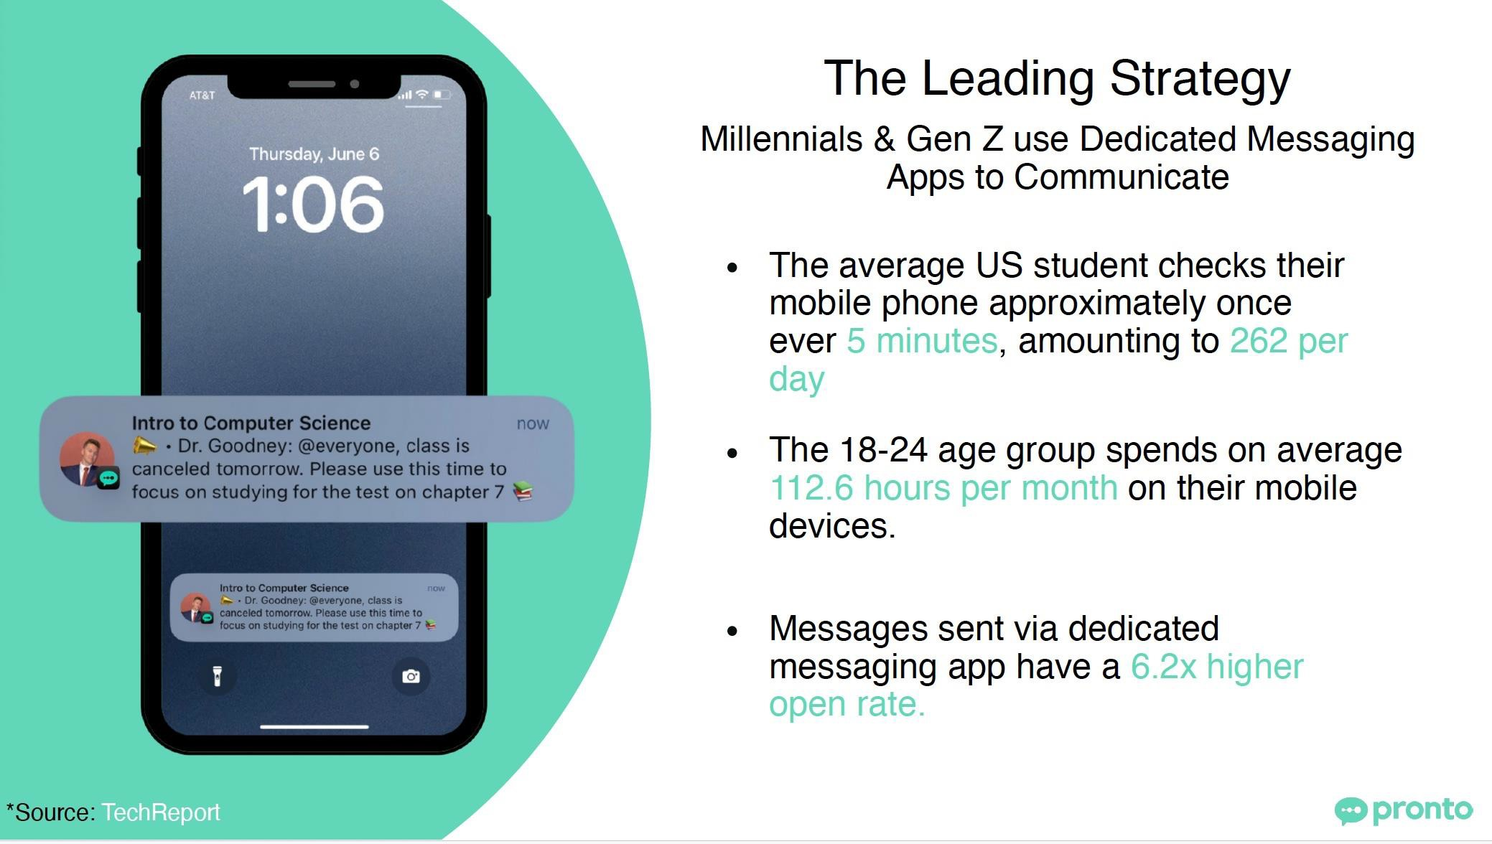
Meeting Students Where They’re At

Slide 7

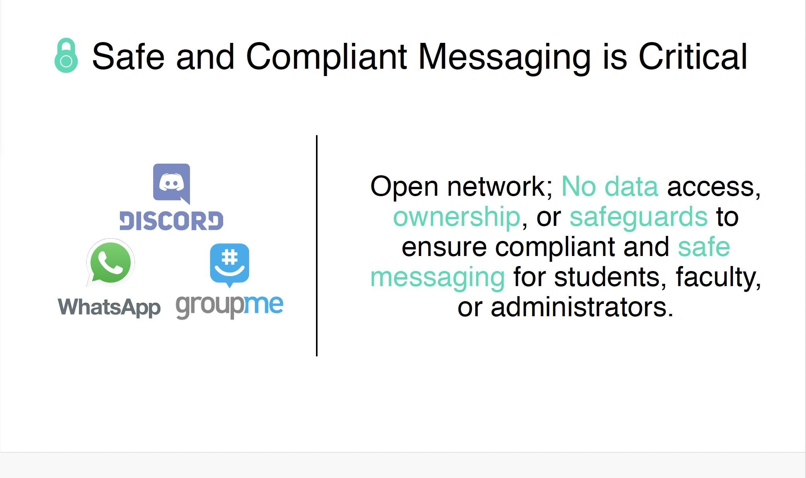


Slide 8
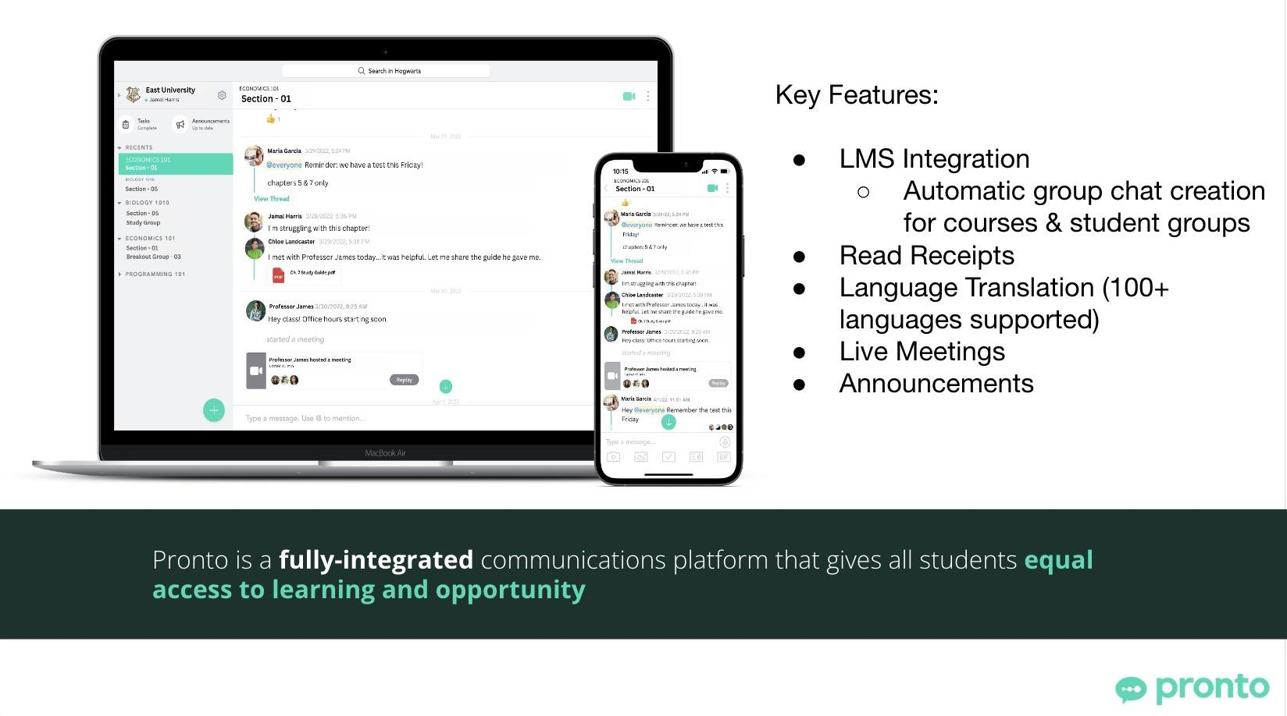

Slide 9
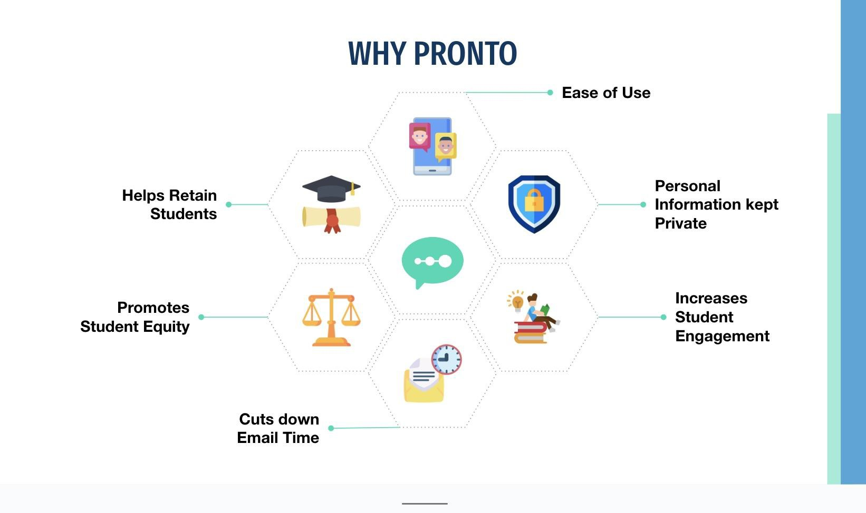

Slide 10
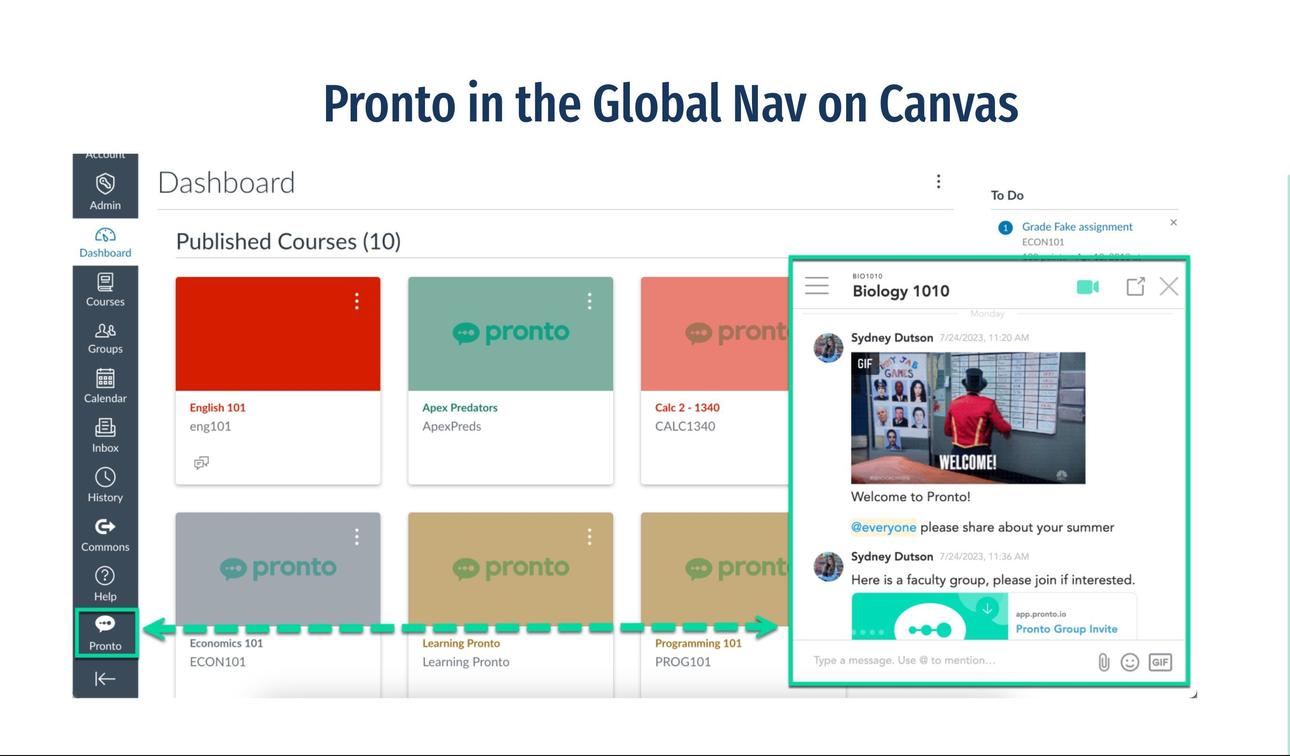

Slide 11
THANK YOU
Contact Me by email at sydney@pronto.io

