Slide 1

Labor Market Rationale in Curriculum
What is it and why does it matter?
Lori Sanchez, Director, Center of Excellence, Chaffey College
Wheeler North, Treasurer ASCCC
2015 Curriculum Institute
July 9, 2015

Slide 2
Today’s Conversation
Overview of the COE
Labor Market Information Need
Resources and available data
Data uses
Data limitations

Slide 3
Today’s Conversation
Overview of the COE
Labor Market Information Need
Resources and available data
Data uses
Data limitations

Slide 4






Who are the Centers of Excellence (COE)?
MULTI
REGIONS
LOCAL
REGION
STATE
Community College
Regional Consortia Chair/Vice Chairs (RCs)
Deputy Sector Navigations (DSNs)
Sector Navigators (SNs)
Technical Assistance Providers (TAPs)
CA Community College Chancellor’s Office (CCCCO)
Notes:
4

Slide 5
About the COE
The Centers of Excellence deliver labor market research customized for community college decision making and workforce development.
As a grant-funded technical assistance provider, the COE work with colleges, regions and the sector networks to:
Identify opportunities and trends in high growth, emerging, and economically critical industries and occupations.
Estimate the gap between labor market demand, available training, and existing or future workers.
Help regions respond to workforce needs by providing them quality information for decision-making.
Notes:
5

Slide 6
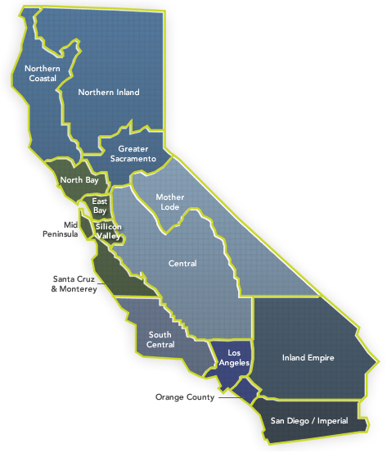
Regional COEs
Region | Director
San Diego-Imperial | Zhenya Lindstrom
Inland Empire/Desert | Lori Sanchez
Los Angeles-Orange | Interim
South Central | Laura Coleman
Central | Interim
Bay Area | John Carrese
North-Far North | Theresa Milan

Slide 7
Today’s Conversation
Overview of the COE
Labor Market Information Need
Resources and available data
Data uses
Data limitations

Slide 8
CC Applications for LMI
Program Review
College or District Strategic Planning
Career Exploration for Students
Program Creation
Grant Application Support
Curriculum Creation and Review
Employer engagement
Regional program alignment
Gap Analysis

Slide 9
The Course Outline of Record: A Curriculum Reference Guide
Need/Justification
New CTE and transfer programs place external research requirements on demonstrating need for these programs and courses.
For CTE programs and courses, this need is more challenging and must rely on:
    labor market data
    potential employer needs
    advisory committee input
    job advertising information

Slide 10
What and why of labor market rationale?
Justification for courses or programs
Skills and knowledge areas align with employer job requirements
Supply of trained candidates to the regional workforce is sufficient and qualified

Slide 11
Need/Justification
The requirement for cyclical program and course assessment and review required by:
Title 5
Education Code
Accrediting Commission for Community and Junior Colleges
Notes:
Central requirement for remaining an accredited institution by the ACCJC

Slide 12
Today’s Conversation
Overview of the COE
Labor Market Information Need
Resources and available data
Data uses
Data limitations

Slide 13
Types of
Labor Market Information (LMI)
Traditional LMI
Employer Advisories
Real Time LMI
Traditional LMI
Real-time LMI
Employer Advisories

Slide 14
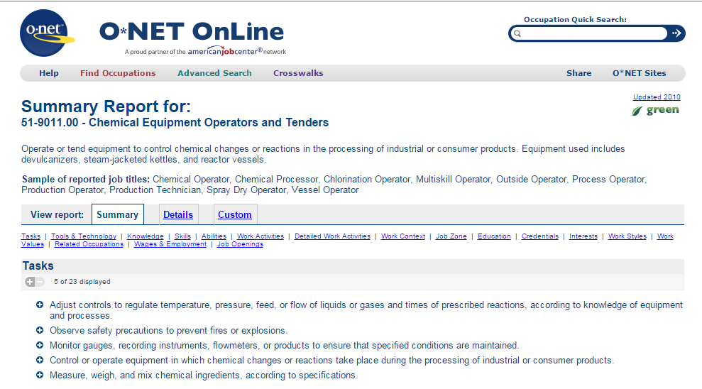
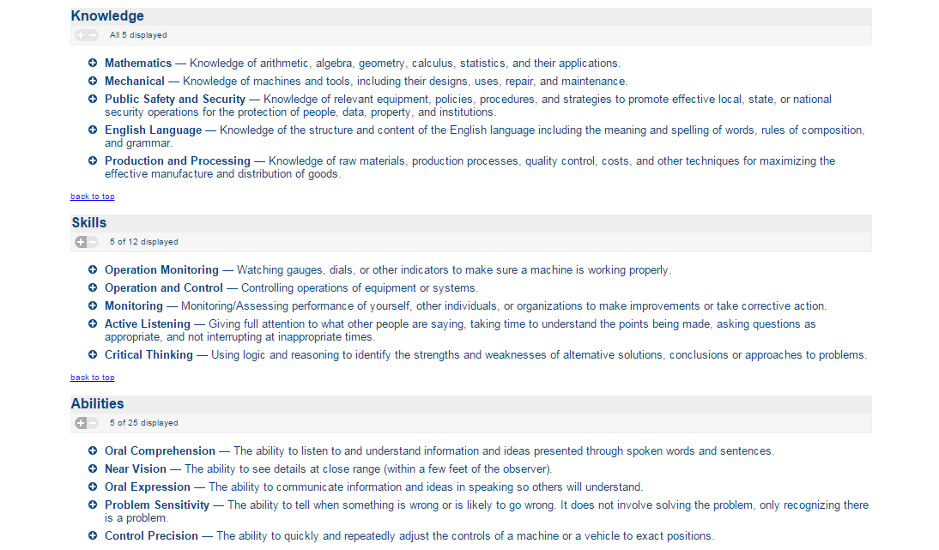
O*NET Online
Occupational Profiles
  Tasks
  Abilities, tasks, knowledge
  Work activities
  Work context
  Education
  Work values
  Wages & employment
  Related occupations

Slide 15

LaunchBoard
www.calpassplus.org

Slide 16
Economic Modeling Specialists, Inc. (EMSI)
Benefits
Limitations
  Occupational reports (customized projections)
  Staffing patterns reports (what occupations are employed in an industry)
  Educational completion data conveniently packaged
  Provides multiple data elements in one place
  Easy to use and quick to share
  Data limitations (e.g. reports data for 2-digit “catch-all” Government NAICS code; no breakdown for public education and other public services)
  No data for emerging industry or occupation
  Projections are based on historic data

Slide 17
What data are available from traditional LMI?
Industry | Occupation
# of jobs | # of jobs
jobs change | jobs change
earnings | earnings
occupations employed by industry | job openings
location quotient | typical minimum education requirement

Slide 18
Employer Advisories
Benefits
Limitations
  Local or regional labor market outlook
  No cost to access employers – advisory committees, skills panels
  Can inform necessary skills for emerging occupations
  Can review existing curriculum for relevance to labor market
  May not have diversity in employers
  Rural areas do not have a large selection
  Employers might not hire all occupations that a program prepares students for

Slide 19
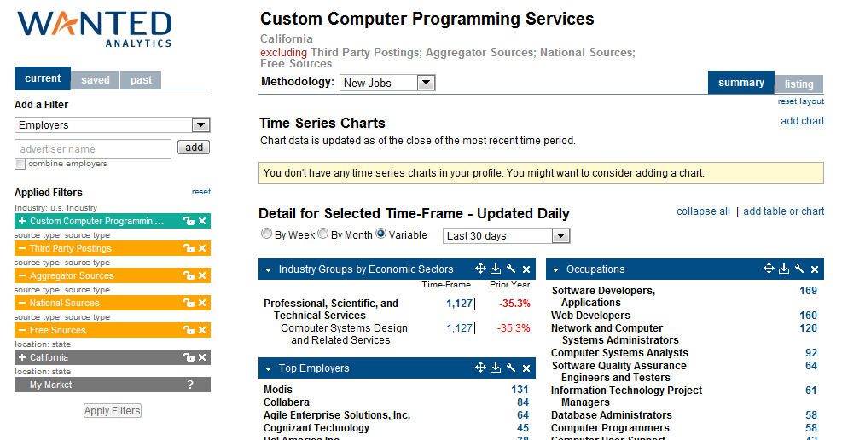
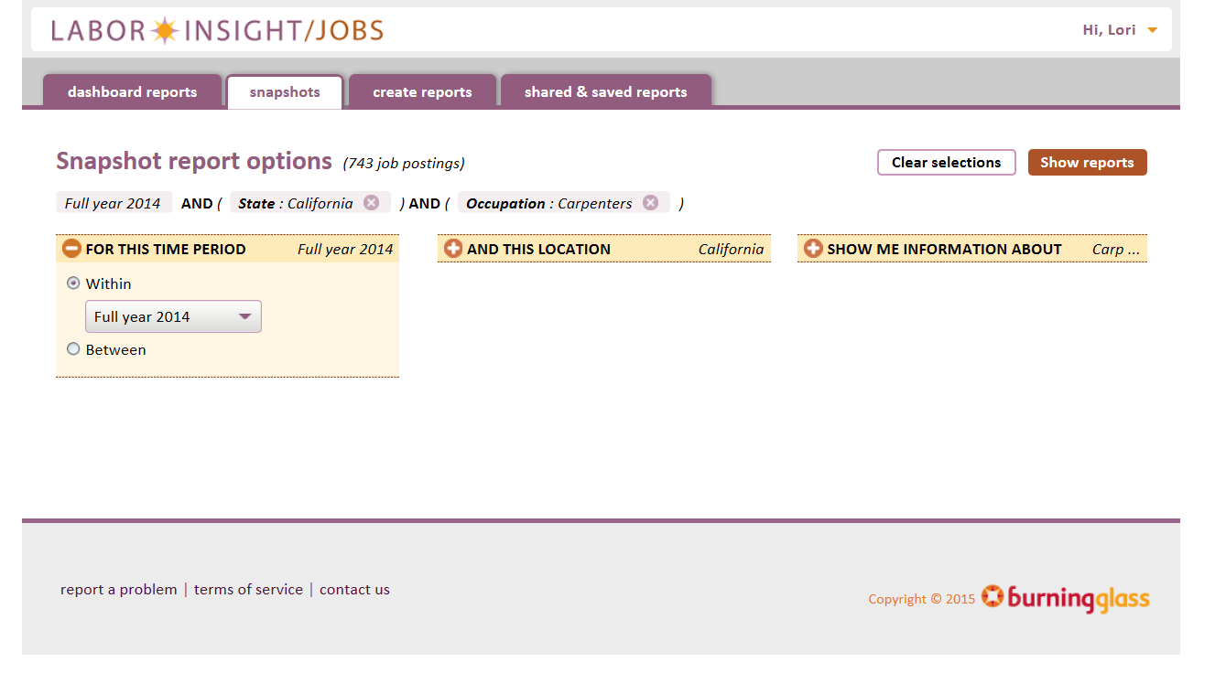
Real time LMI
Labor market intelligence derived from the analysis of job postings and resumes placed into public and private labor exchanges.
Constantly “spidering” to thousands of online job boards such as Monster, Indeed, Dice…data aggregates job posting information pulled from the internet.

Slide 20
What data are available from
Real-Time LMI?
Industry | Occupation
# of job ads | # of job ads
top employers | desired education level
top locations (city, county, MSA) | desired skills
top occupations | desired certificates
job titles | job titles

Slide 21
Where can you find data?
Campus Institutional Effectiveness or Institutional Research offices
Centers of Excellence
CalPass Launchboard
Regional Deputy Sector Navigators
EDD Labor Market Information Division

Slide 22
Today’s Conversation
Overview of the COE
Labor Market Information Need
Resources and available data
Data uses
Data limitations

Slide 23
Data Uses for Faculty
To support the creation of “experimental” courses
To identify program/curriculum needs to validate usefulness
To align curriculum to employer hiring requirements
To count program successes – students finding employment, etc.
To inform overall college alignment with local labor market

Slide 24
Data Uses for Curriculum Review Committee
To analyze alignment of curriculum with employer/labor market needs
To understand projected labor market demand for occupations related to a program
To review employer comments related to curriculum content
To understand emerging labor market trends that may impact college program/curriculum offerings

Slide 25
Things to look for
Projected job growth that justifies the course or program
Wages that are at or above the regional living wage
Information from employers about skill and knowledge expectation
Identified trends in the labor market related to course or program

Slide 26
Today’s Conversation
Overview of the COE
Labor Market Information Need
Resources and available data
Data uses
Data limitations

Slide 27
What the data is not
Not rapidly changing
Not the whole picture
Not representative of rural and urban areas equally
Not created by COE
Not the enemy
Not difficult to understand nor too difficult to obtain

Slide 28

Online @
www.coeccc.net
Notes:
28

Slide 29
Thank You!
Contact a COE near you - www.coeccc.net/contact
Visit us online at www.coeccc.net & www.path2careers.net
Lori Sanchez
Director, Desert/Inland Empire Region
lori.sanchez@chaffey.edu

